Slide 1
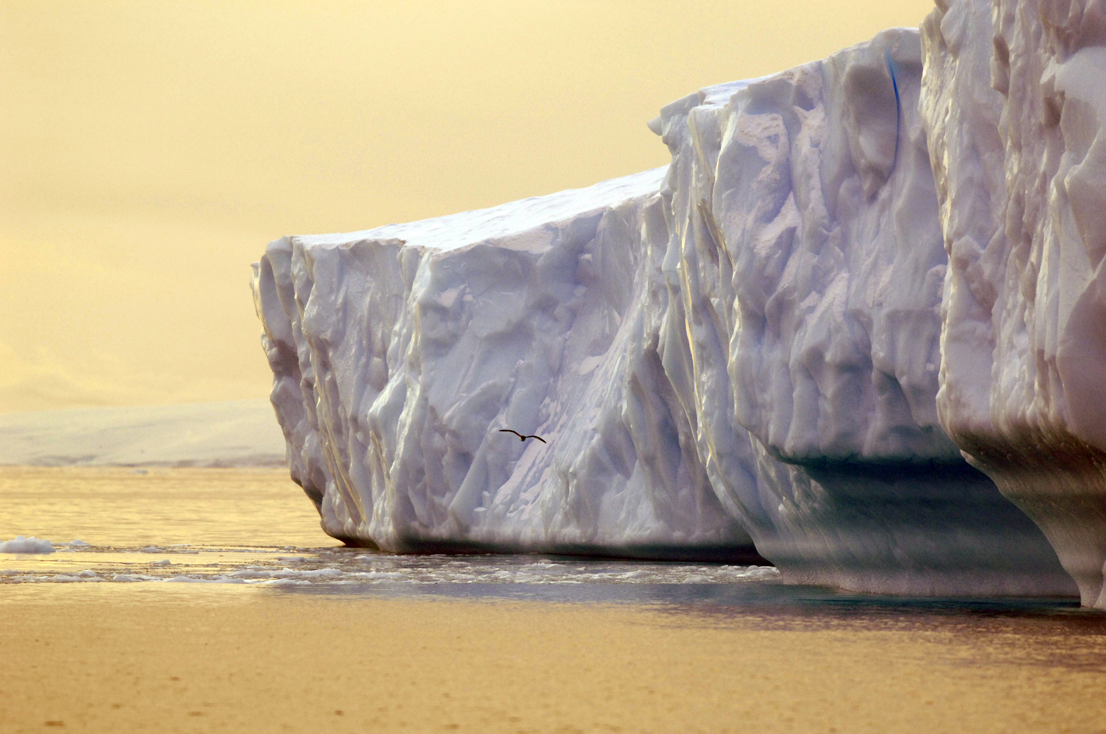

Confessions of a ‘young’ scientist:
Krill Predator Ecology and the
SO GLOBEC Experience
Ari S. Friedlaender
Duke University Marine Laboratory, Beaufort, NC , USA

Slide 2

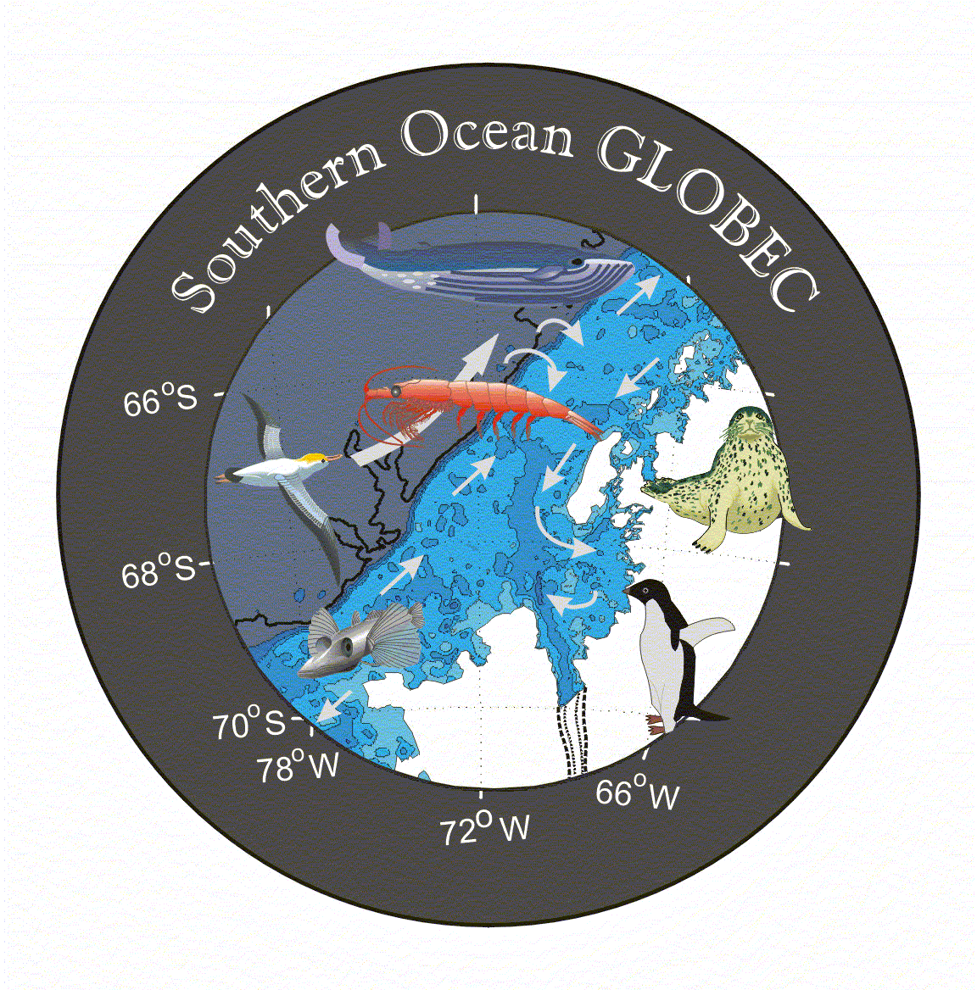
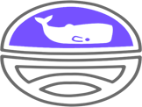
Office of Polar Programs
Andy Read
Pat Halpin
Dick Barber
Eileen Hofmann
Dan Costa
Deb Thiele
Bill Fraser
Peter Wiebe
Meng Zhou
John Hildebrand
Jose Torres
Kendra Daly
Sue Moore
Chris Ribic
John Klinck
Gareth Lawson
Joe Warren
Ana Sirovic
Eric Chapman
Captains, Crew, Officers of the LM Gould and NB Palmer
Raytheon Polar Services Company: MTs, ETs, MPCs,

Slide 3
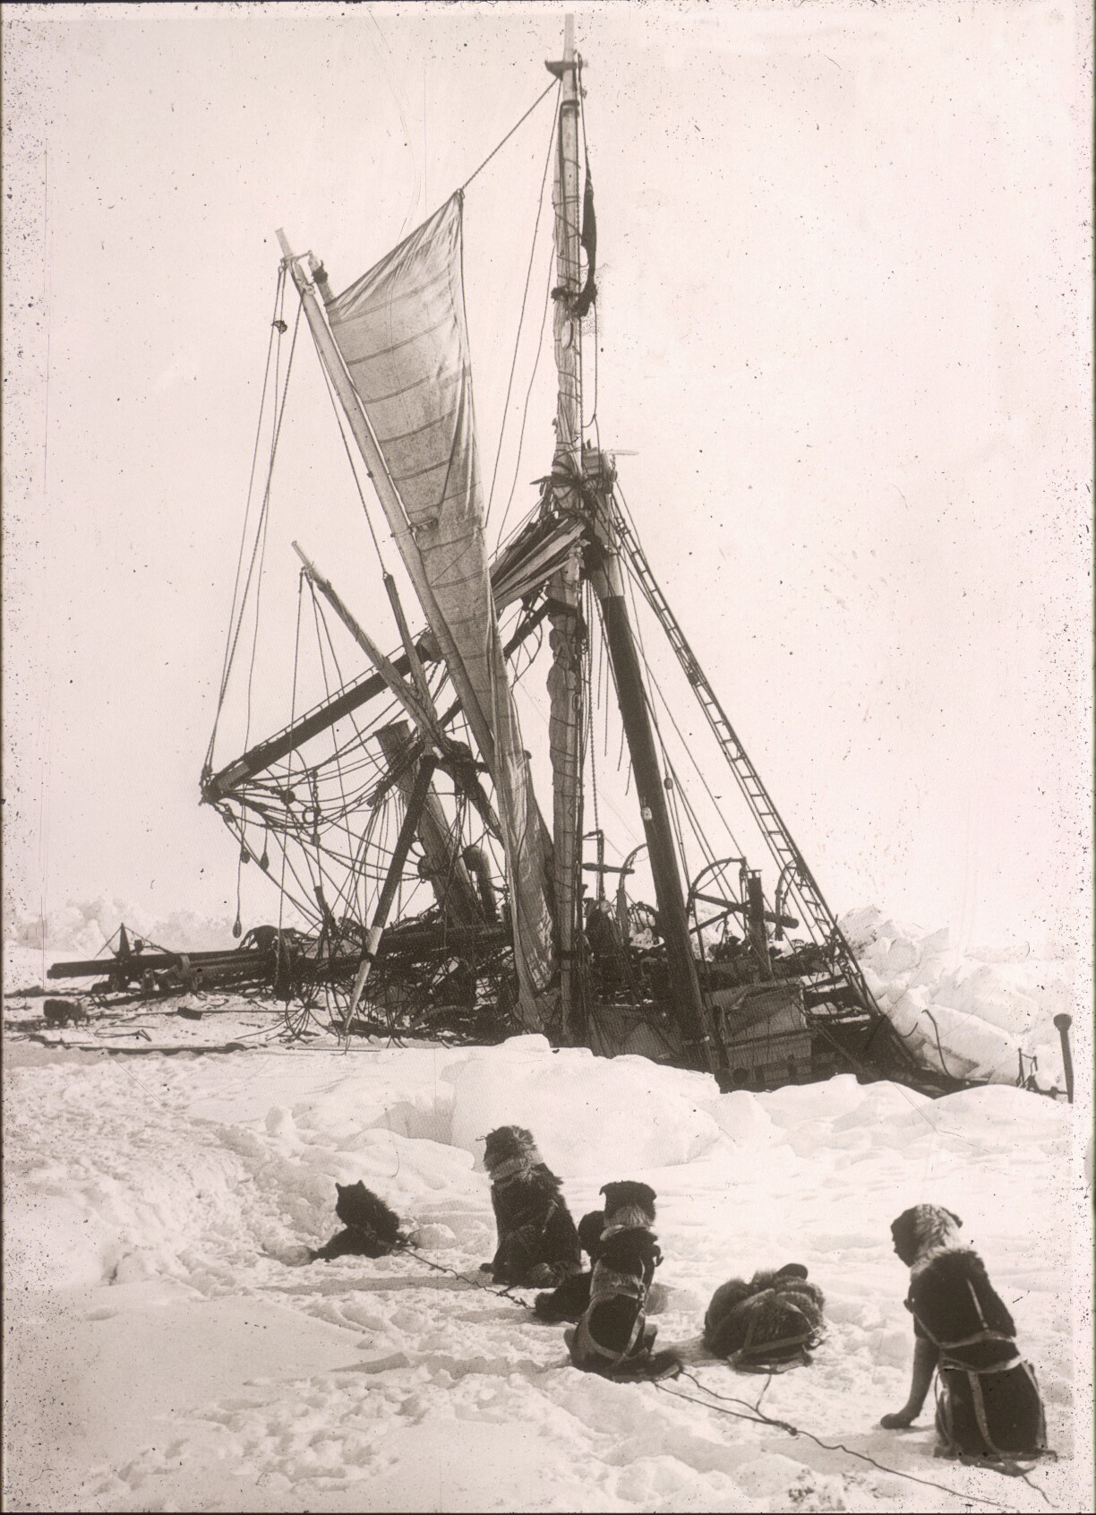
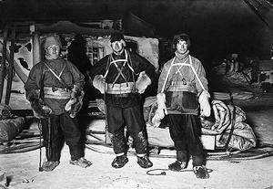
‘Polar research is at once the cleanest and most isolated way of having a bad time which has been devised’.
~ Apsley Cherry-Garrard,
The Worst Journey in the World
Notes:
And in far fewer words with a slightly different sentiment, the opening lines of the worst journey in the world

Slide 4
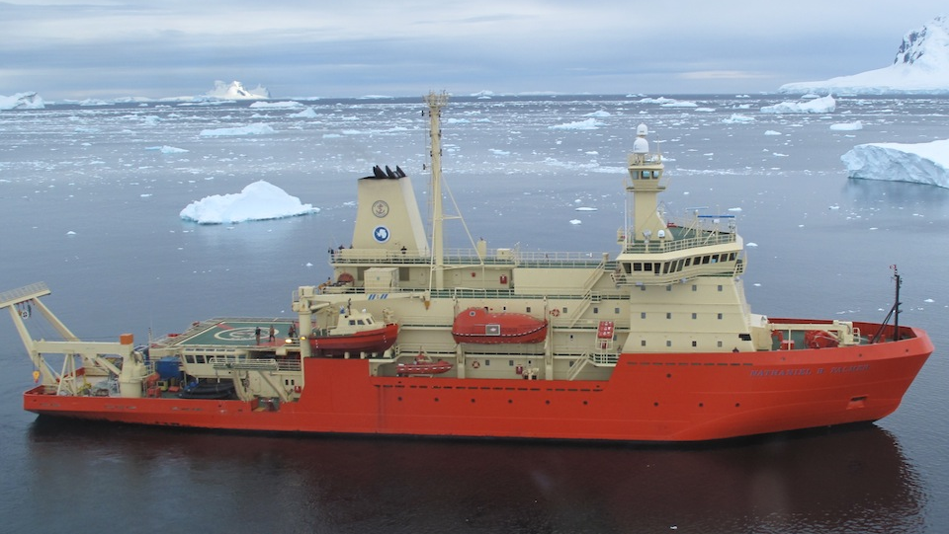
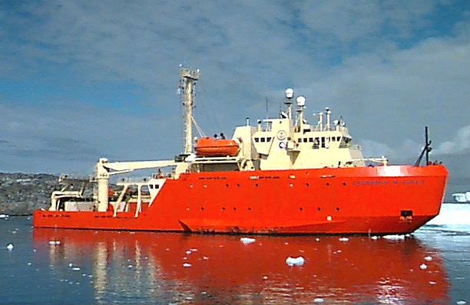
Getting There and Back
RVIB Nathaniel B Palmer ARSV Lawrence M Gould
Notes:
One of the reasons for the grief and struggle was the technology of the day.
Shackleton and his crew found out the hard way that “what the ice gets, the ice keeps”
Luckily, today we have far more able means of getting to and from the antarctic, which also allow for large-scale multidisciplinary cruises to be conducted in plush comfort
As the whale observer on these ships you are basically a necessary pest and are banished to the most far off part of the ship.
My office was located here

Slide 5

SO GLOBEC
Use emerging technology and multidisciplinary research
Test hypotheses regarding interactions between environment, krill, and predators
To understand the physical and biological factors that contribute to enhanced Antarctic krill growth, reproduction, recruitment and survivorship
Notes:
Soon thereafter, the southern ocean global ecosystem dynamics program was initiated
This major project was designed to use emerging technology and multidisciplinary research techniques to better understand the physical and biological factors that contribute to enhanced antarctic krill growth, reproduction, recruitment, and survivorship off the WAP

Slide 6
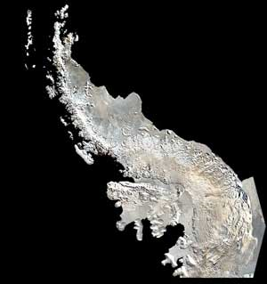
Western Antarctic Peninsula (WAP)
Rich in krill and predators
Physical features act to retain and maintain krill stock
  Complex bathymetry
  Annual sea ice cover
  Cyclonic gyres
  Deep water intrusions on to shelf from the Antarctic Circumpolar Current (ACC)
Marguerite
Bay
www.studentsonice.com/.../antpenmapNDSU.jpg
Notes:
Getting down to business,
The Western Antarctic Peninsula (WAP) is a biologically rich area known to support a persistent and large standing stock of Antarctic krill and large populations of top predators, including baleen whales which depend entirely on this food resource.
Marguerite Bay, where some of my research is being conducted, is a dynamic environment with complex bathymetry and coastal currents, forced at some level by sea ice melt, cyclonic gyres and eddies and episodic intrusions of circumpolar deep water from the antarctic circumpolar current
All of these features help to make this area an important location for krill and krill predators

Slide 7
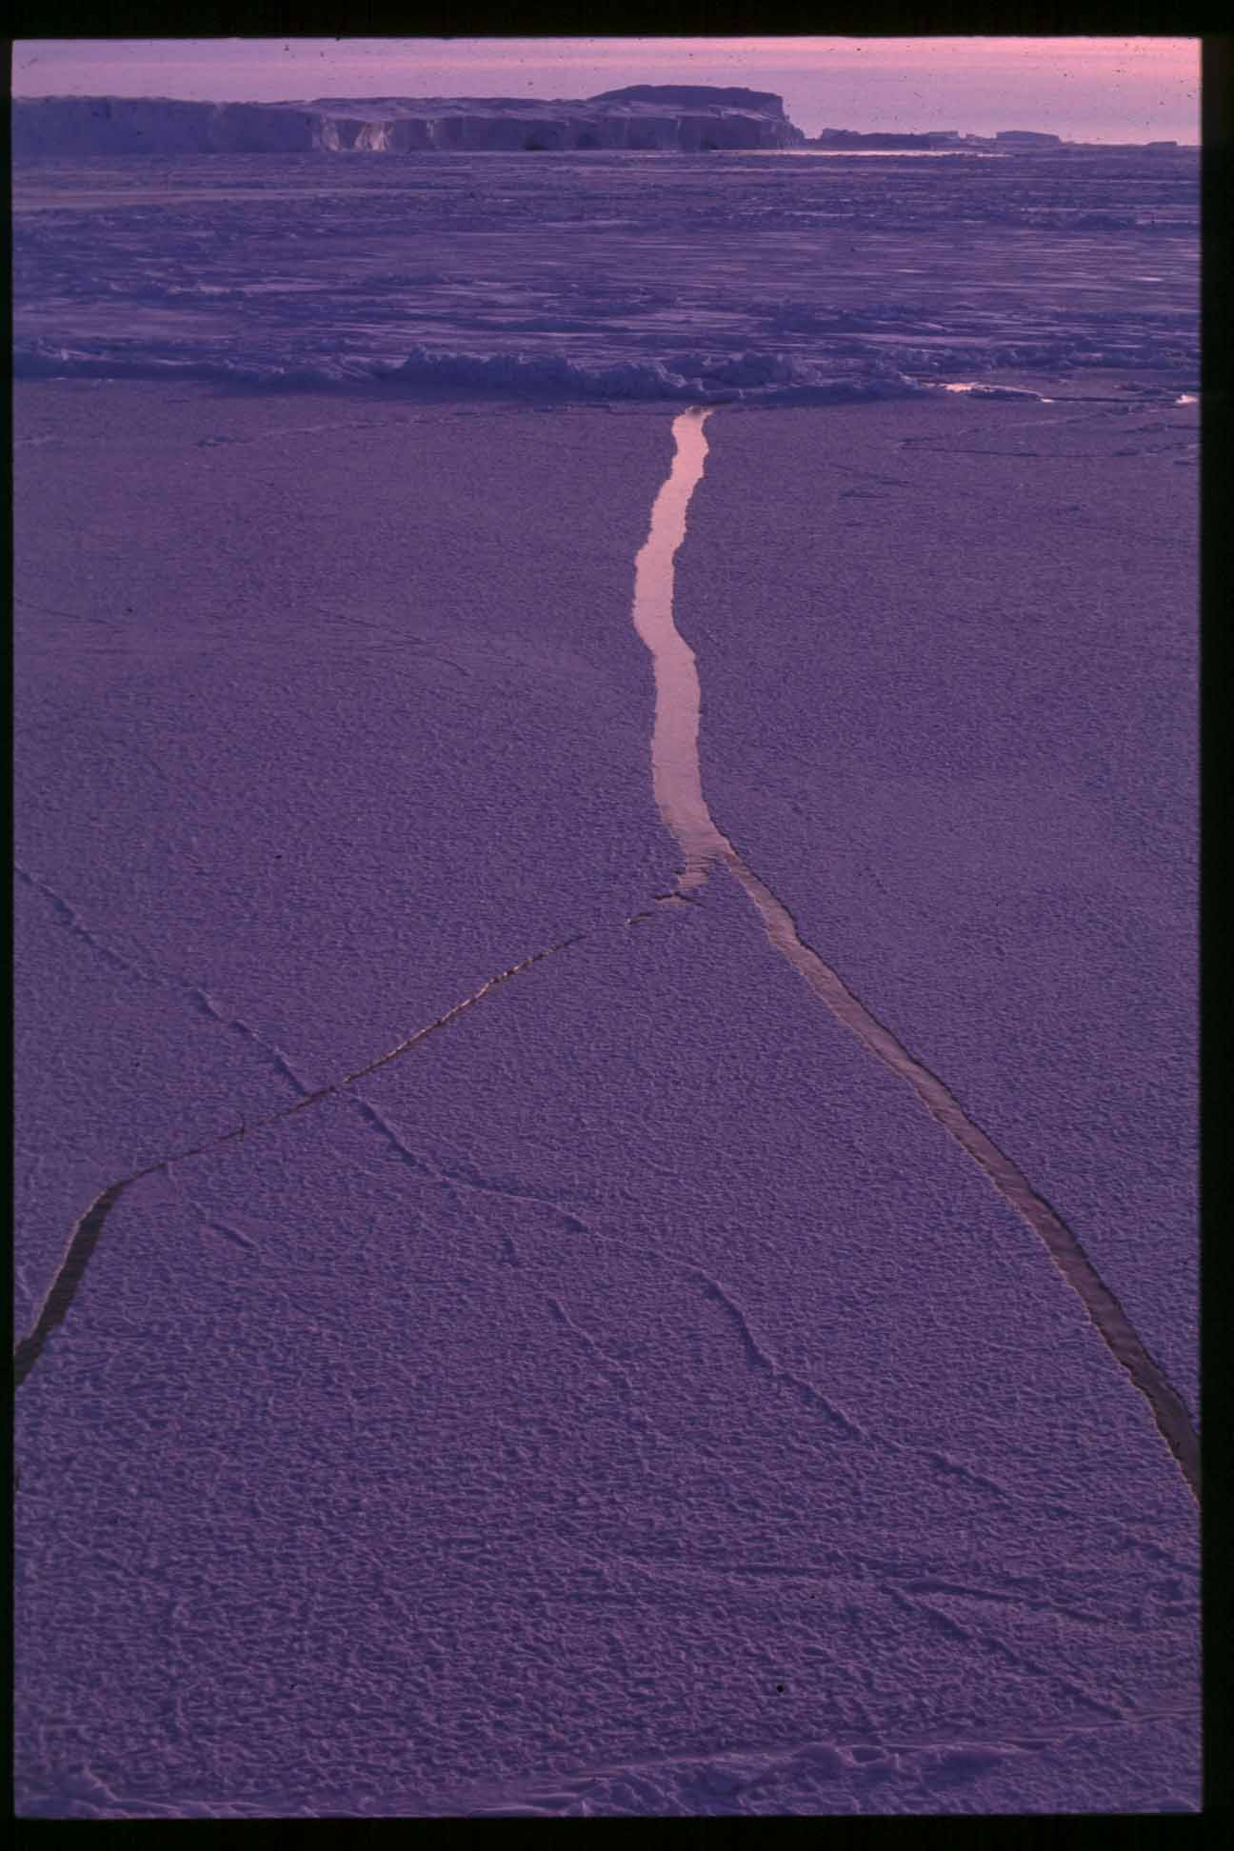
Sea Ice
Refuge and habitat for krill
Platform for seals and penguins
Substrate for algal/microbial communities
Covers 40-200 million km² annually
  Extreme inter-annual variability
Boundary for predators to forage
Notes:
The annual advance and retreat of sea ice around antarctica is an integral feature contributing to annual productivity of the marine ecosystem
Sea ice acts as a refuge and habitat for krill, a platform for seals and penguins to haul out on and breed, and a substrate for algal communities
Annually, winter extent covers 200 million square kilometers of ocean, about twice the size of the us, and at its summer minimum about 40 million square kilometers are covered
The boundary between the ice and ocean, the marginal ice edge zone has also been shown to be a very important place for krill and predators alike

Slide 8
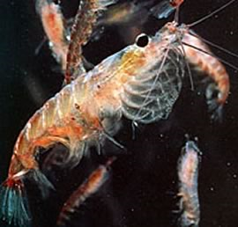
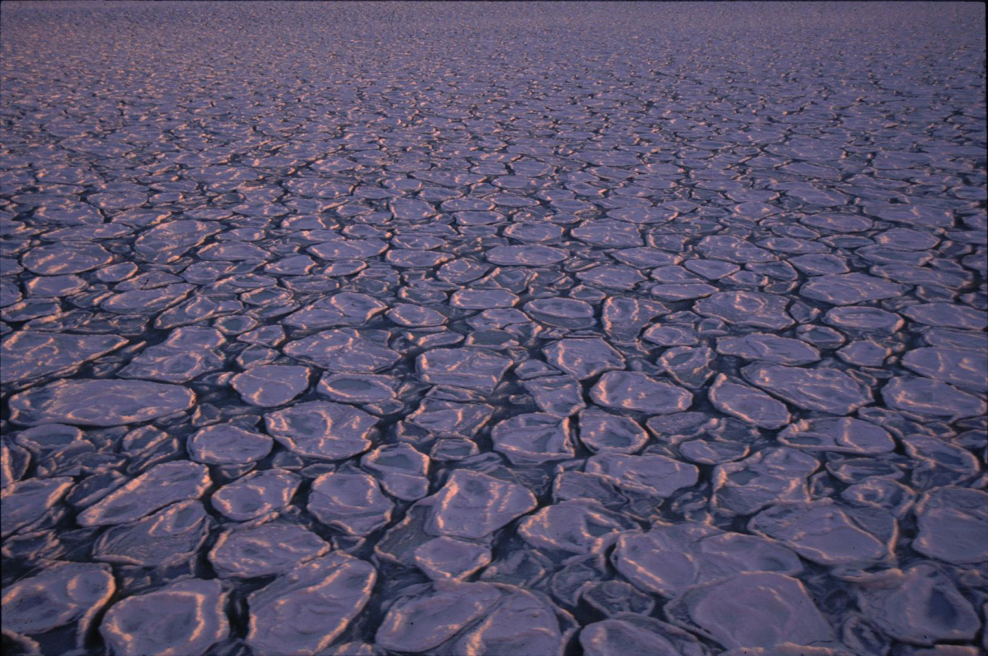
Antarctic Krill (Euphuasia superba)
Primary food item for whales, seals, penguins, seabirds
Tightly coupled with marginal ice edge zone
  Summer foraging
  Over-wintering habitat
Winter sea ice extent linked to abundance and survival
Sea ice extent affects recruitment and distribution of krill
Notes:
Baleen Whales, seals, and seabirds depend entirely or to a large extent on Antarctic krill as a food resource
Physical forcing mechanisms determine, at least in part, patterns of productivity, recruitment, survival, and the distribution of krill
Krill are long-lived, are tightly coupled with the marginal ice edge zone to forage on sea ice algae in summer, and rely on under ice habitat to over-winter and as refuge from predators
Similarly, the distribution of krill predators has been linked to areas around sea ice margins
Several recent studies have linked the extent of winter sea ice to krill abundance patterns and survival rates
Thus, inter-annual changes in sea ice extent affect the recruitment and distribution patterns of Antarctic krill and potentially those of their predators

Slide 9
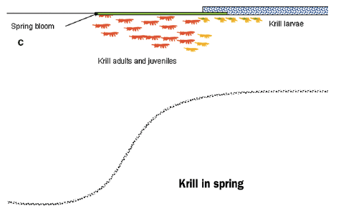
Krill life cycle & seasonal movement
From Nicol (2006)
Notes:
These figures show the distribution of different life stages of krill in relation to the coast and sea ice during different seasons of the year
In summer, spawning females head offshore and deposit eggs while the rest of the adult population stays near the continental shelf break, and juvenile krill remain closer to shore
As sea ice advances in autumn, larval krill are found under sea ice near its edge, while adults and juveniles remain farther inshore and in deeper areas
And then in spring as the sea ice retreats, adult krill and juveniles aggregate at the ice edge to forage

Slide 10
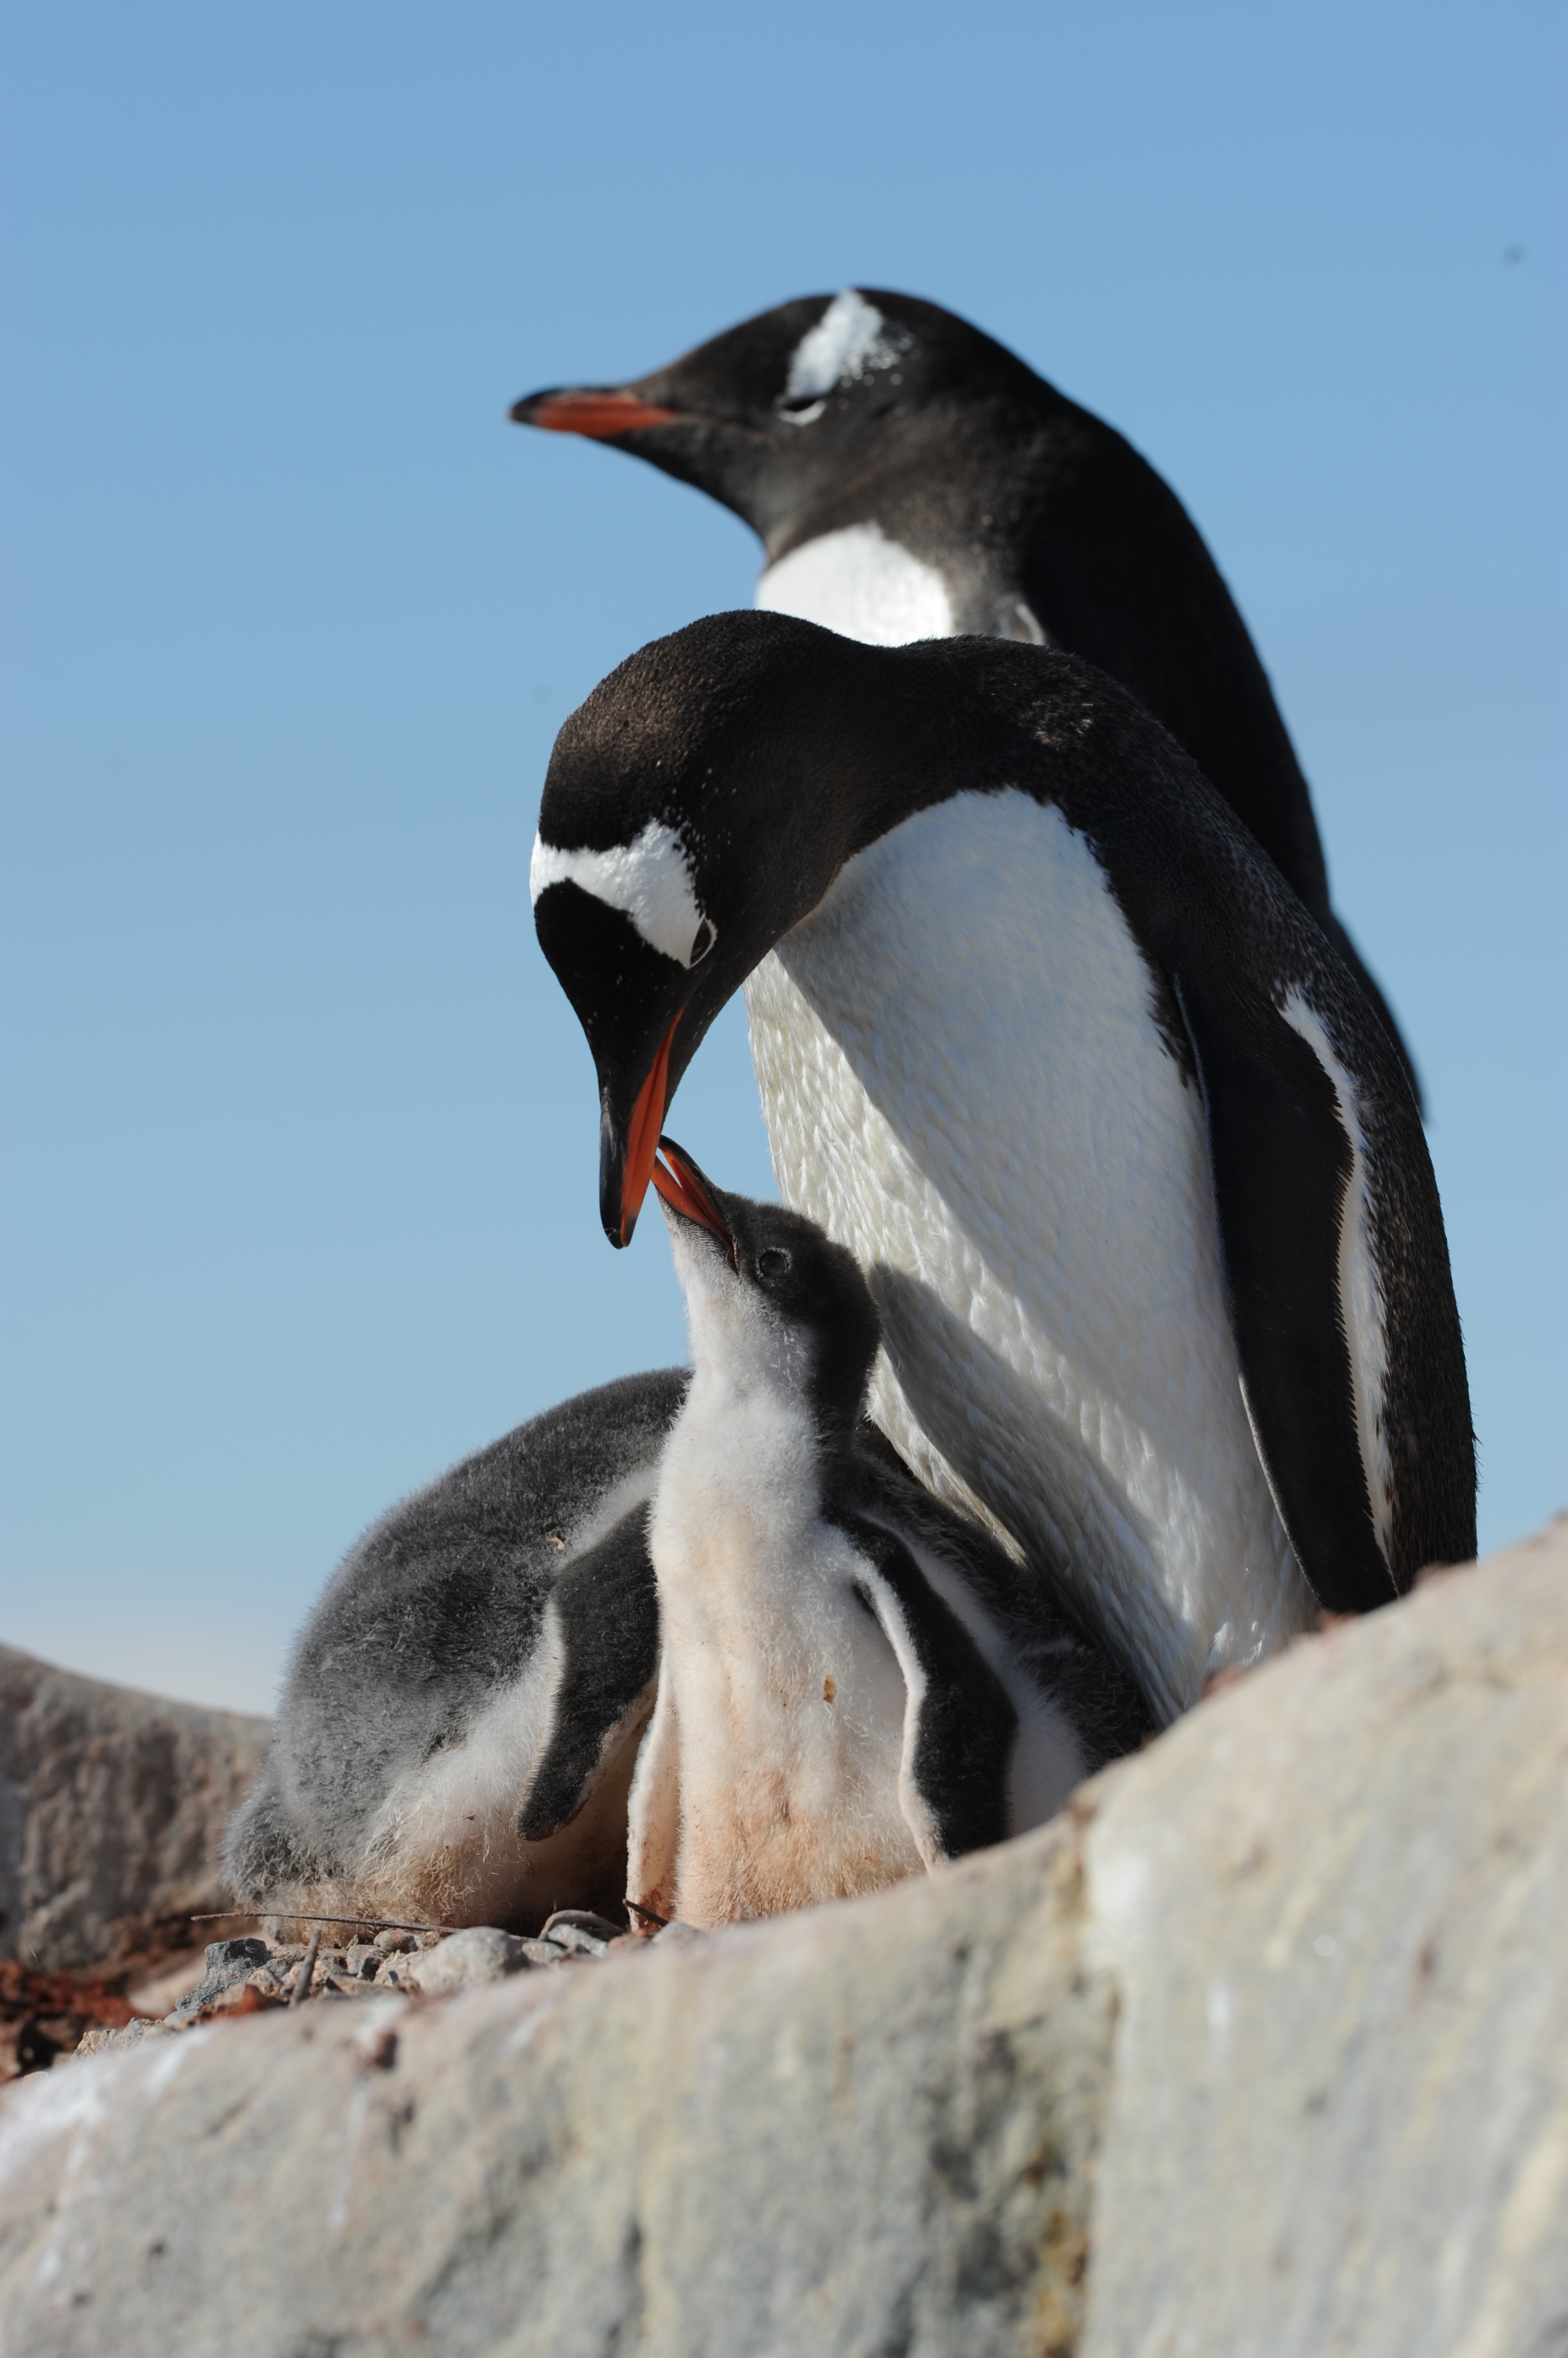
Climate Variability in Antarctica
Many species evolved life histories to cope with change and variability
WAP warming very fast
Winter sea ice extent and duration are shortening
Krill density declining (by order of magnitude around the WAP)
Availability to different predators may be changing
Notes:
Climate variability affects ecosystems at both physical and biological levels and many species have evolved life history strategies to cope with change
The wap is warming at a faster rate than most areas on the planet
And winter sea ice extent and duration are shortening
krill demography is directly tied to physical forcing mechanisms like winter sea ice extent, several recent studies have shown krill density to be declining over large scales
Due to their dependence on a single prey item heavily influenced by climate forcing, krill predators such as penguins, seals, and whales are vulnerable to changes in prey levels.

Slide 11
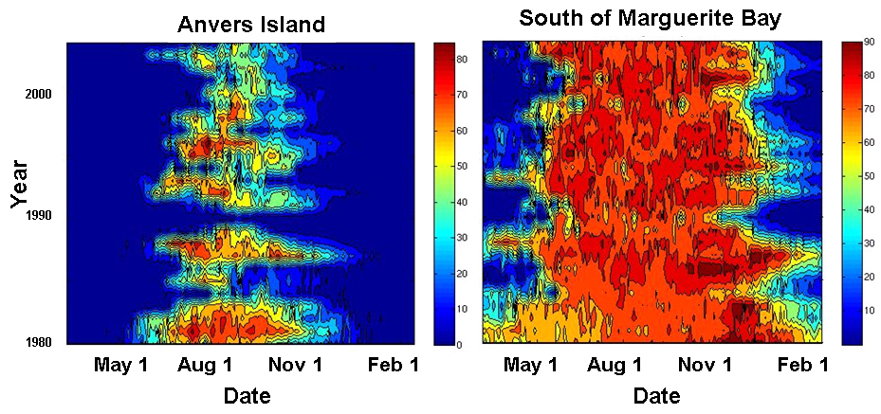

WAP Sea Ice Change: Summary

Slide 12
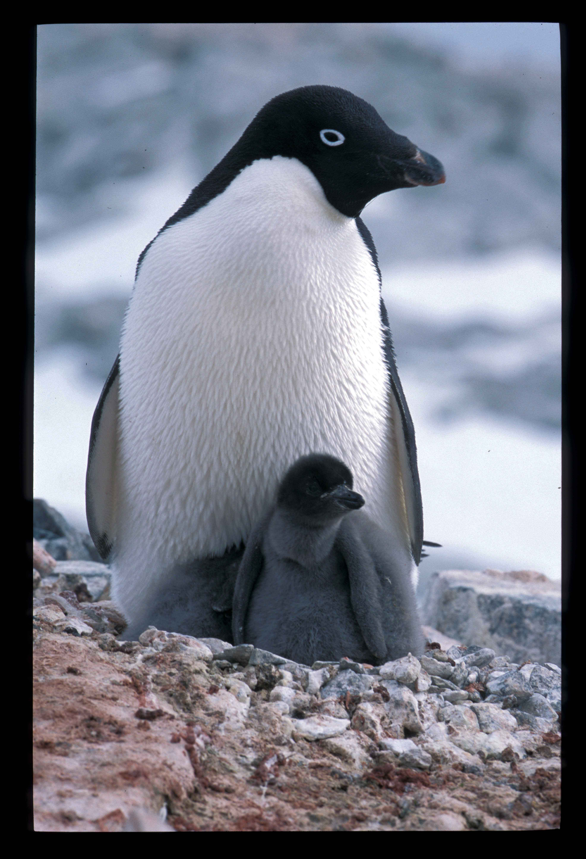
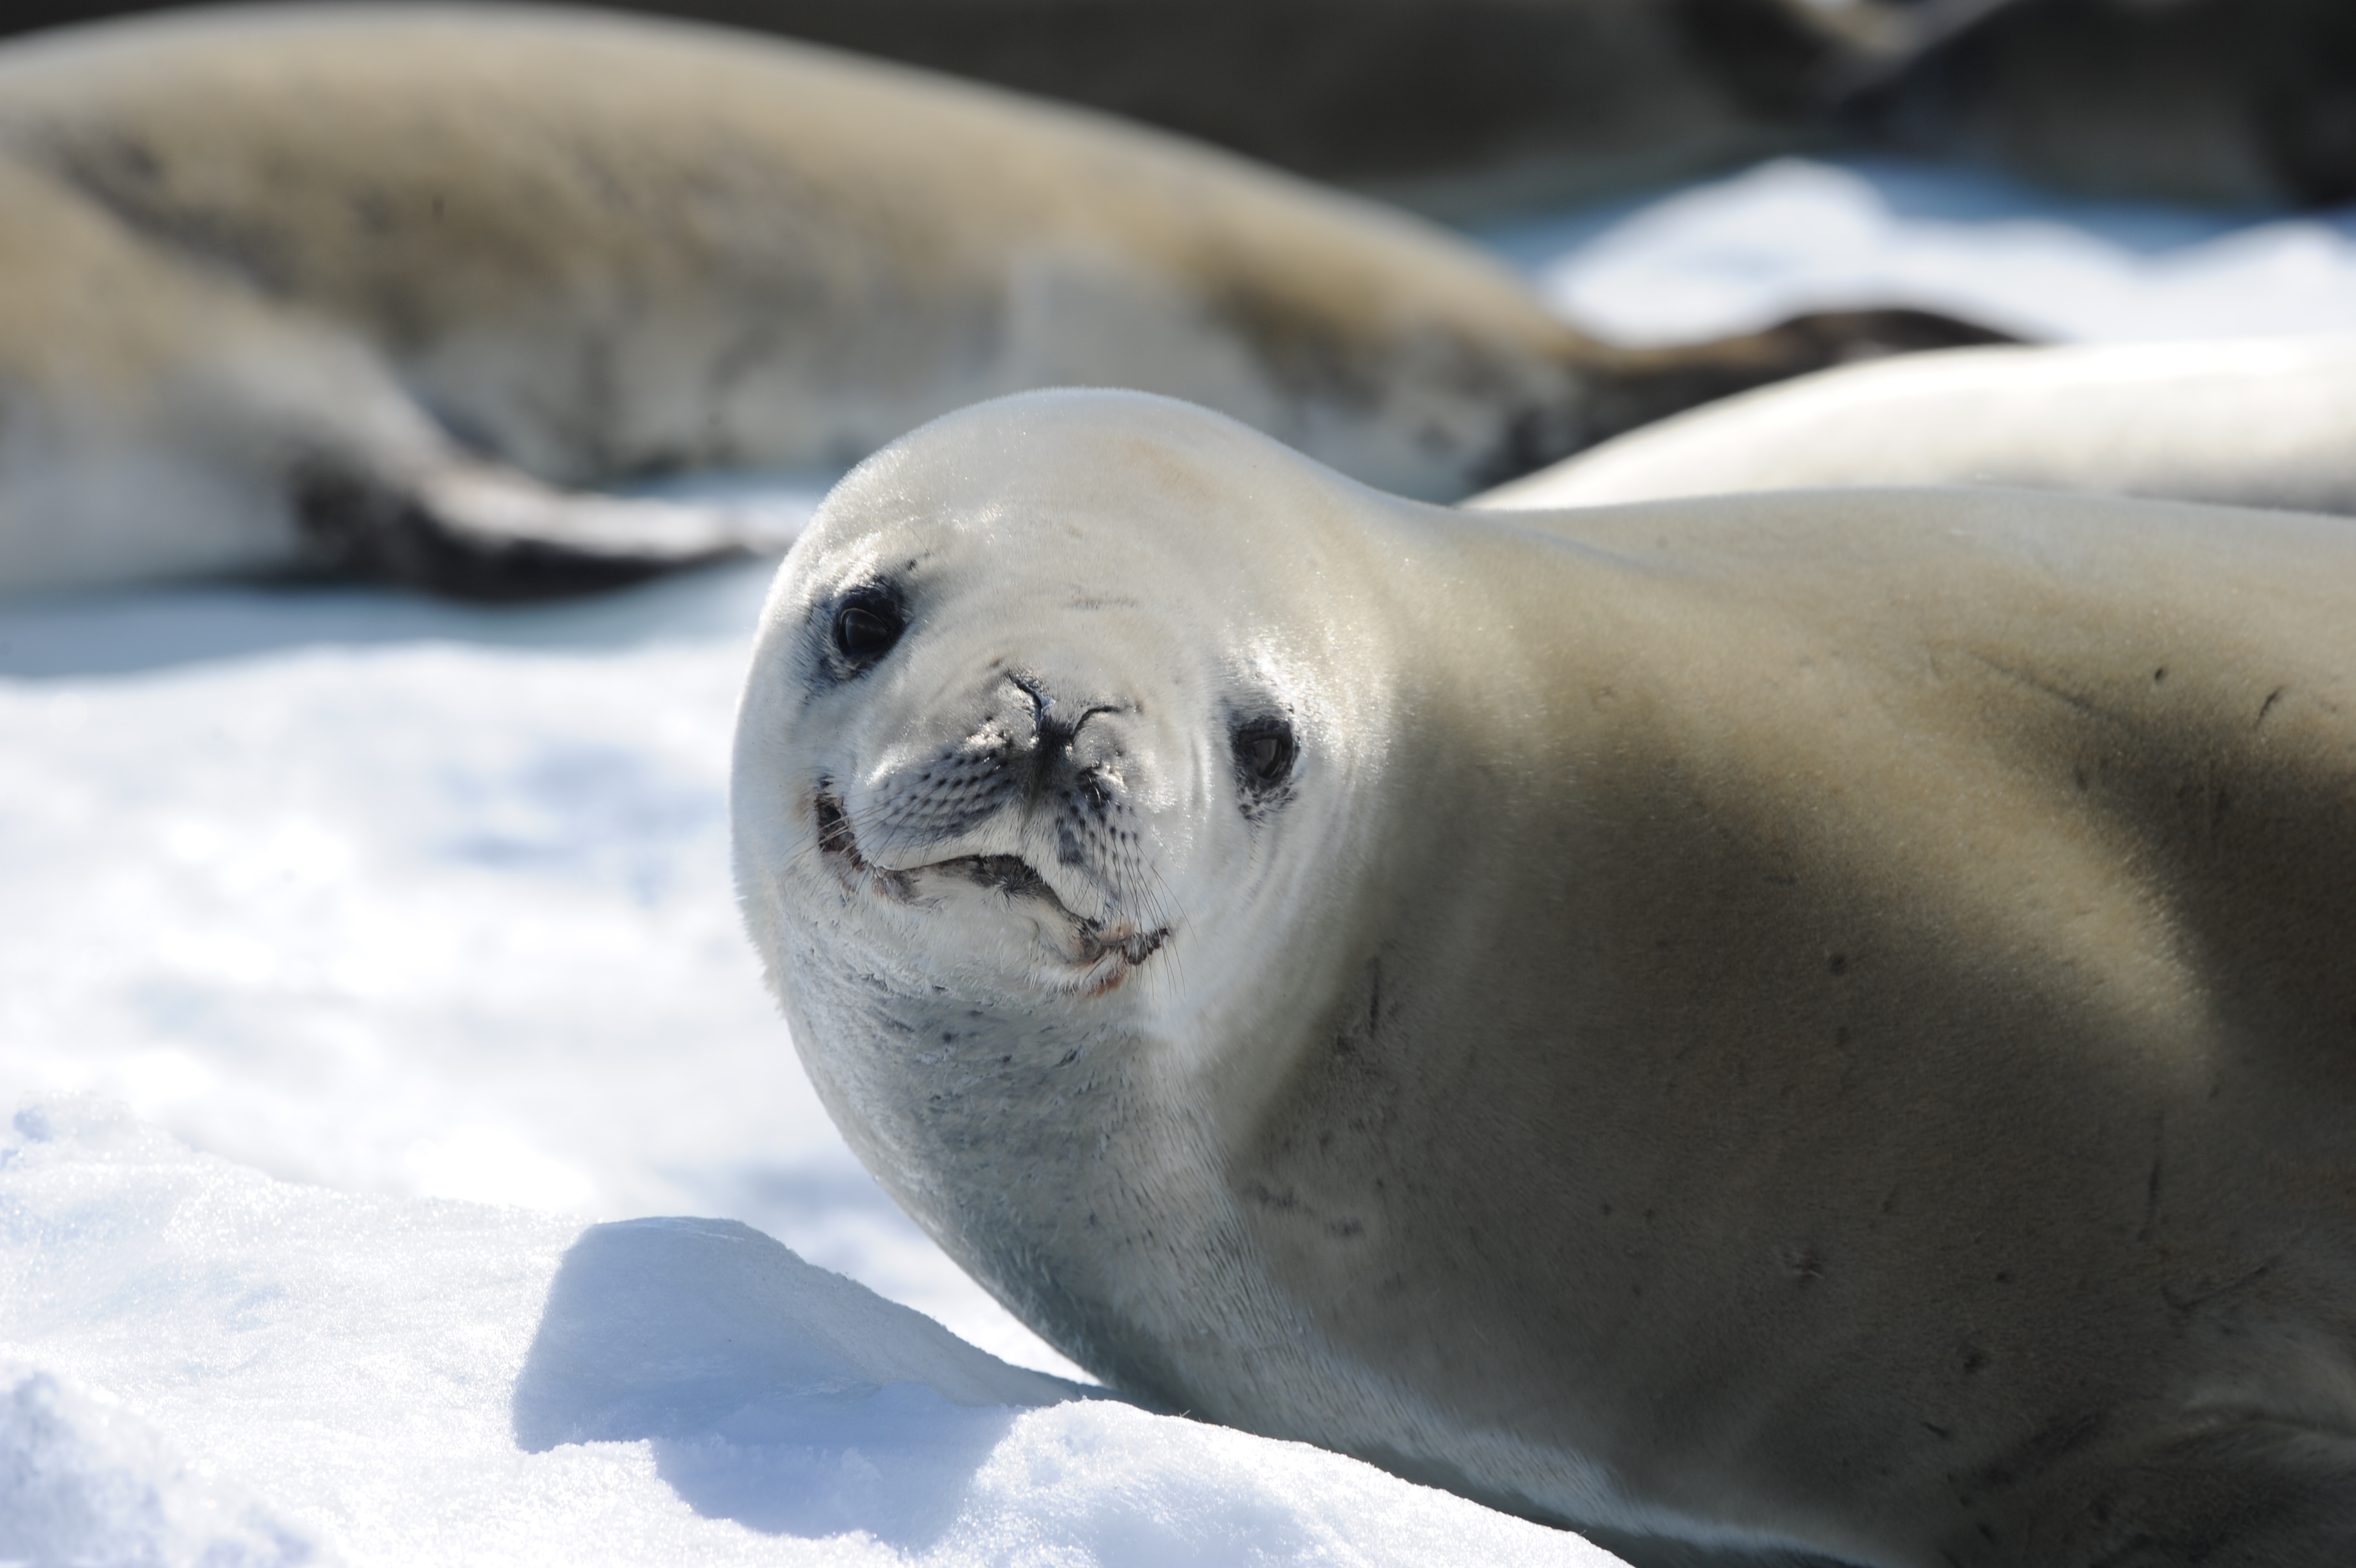
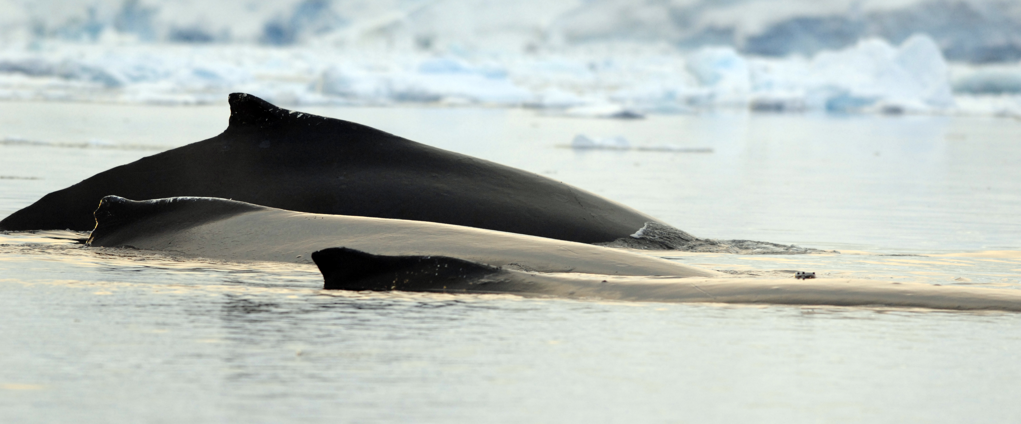
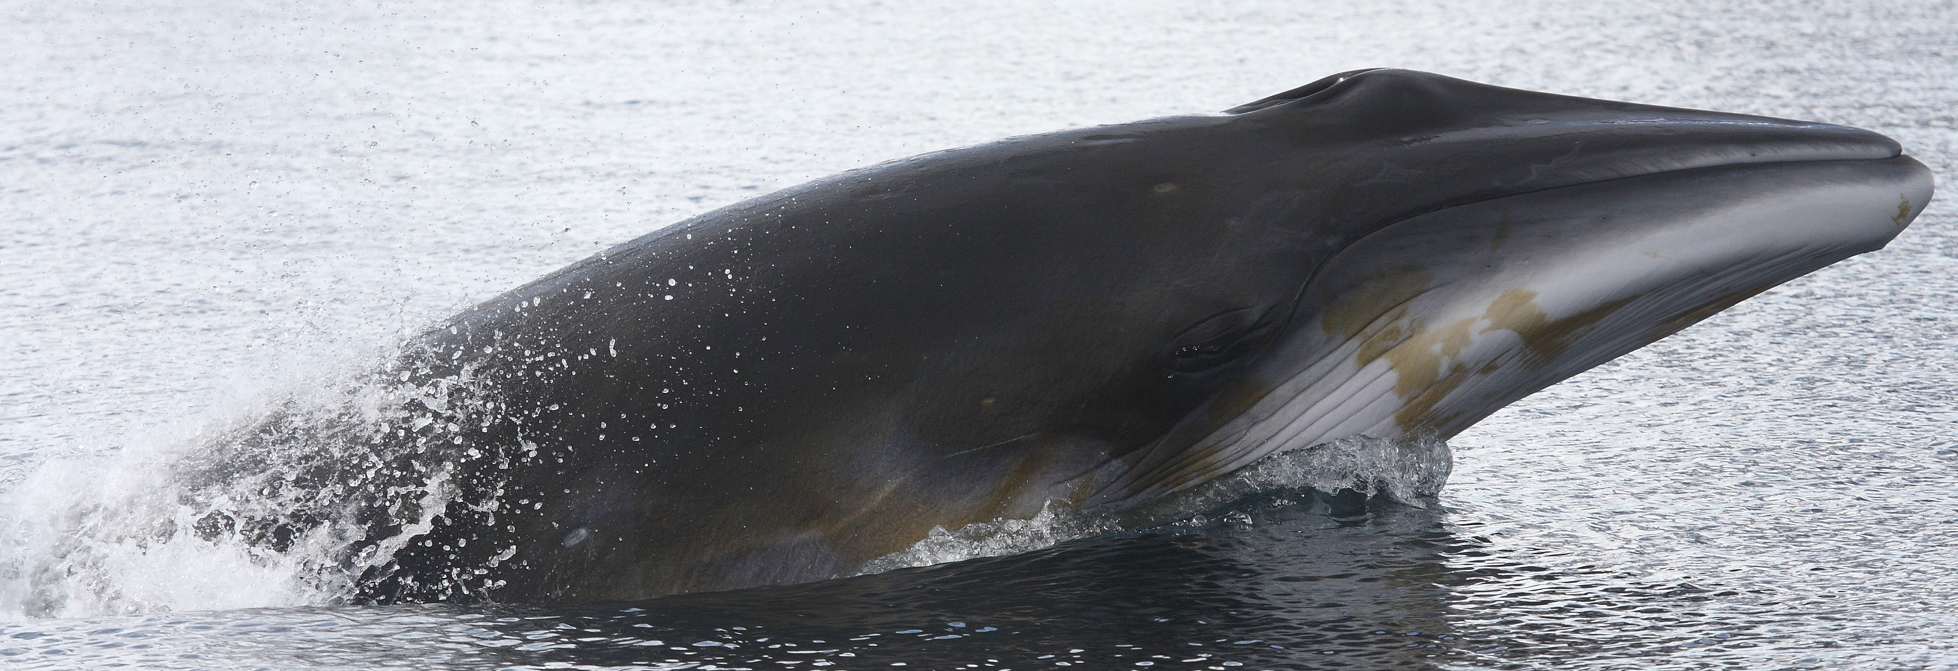
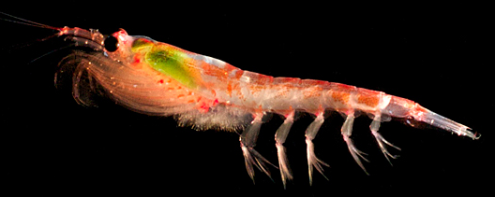
The Players

Slide 13
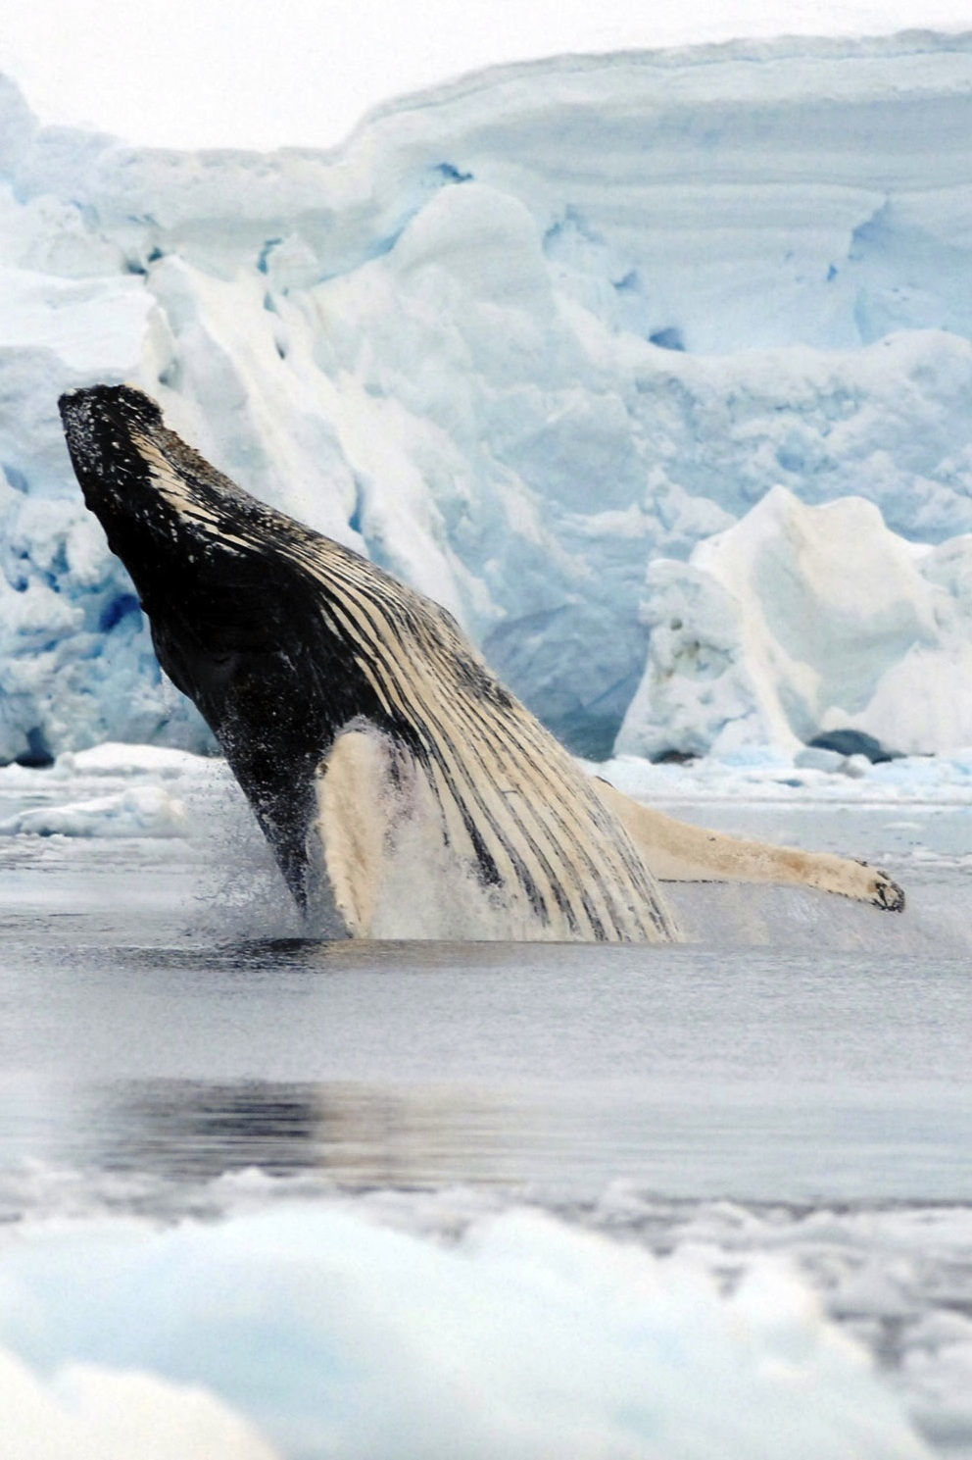
Antarctic Whale Research (pre-GLOBEC)
Whaling records
  Biology, life history, stock structure, morphology
  large-scale distribution patterns in relation to physical features
Coarse surveys over broad spatial scales
Correlation with physical features which may aggregate prey
Few studies quantitatively linking whales to their prey and environment
Notes:
To date, much of the knowledge about the biology, life history, and stock structure of cetaceans in the antarctic come from commercial whaling samples.
More recently, several coarse surveys have been conducted to gain better estimates of population numbers over broad spatial scales
Whaling records have also been used to show correlations between physical features such as the southern boundary of the acc and where whales were killed
There is quite a paucity of data linking cetacean distribution directly to their prey in antarctica

Slide 14
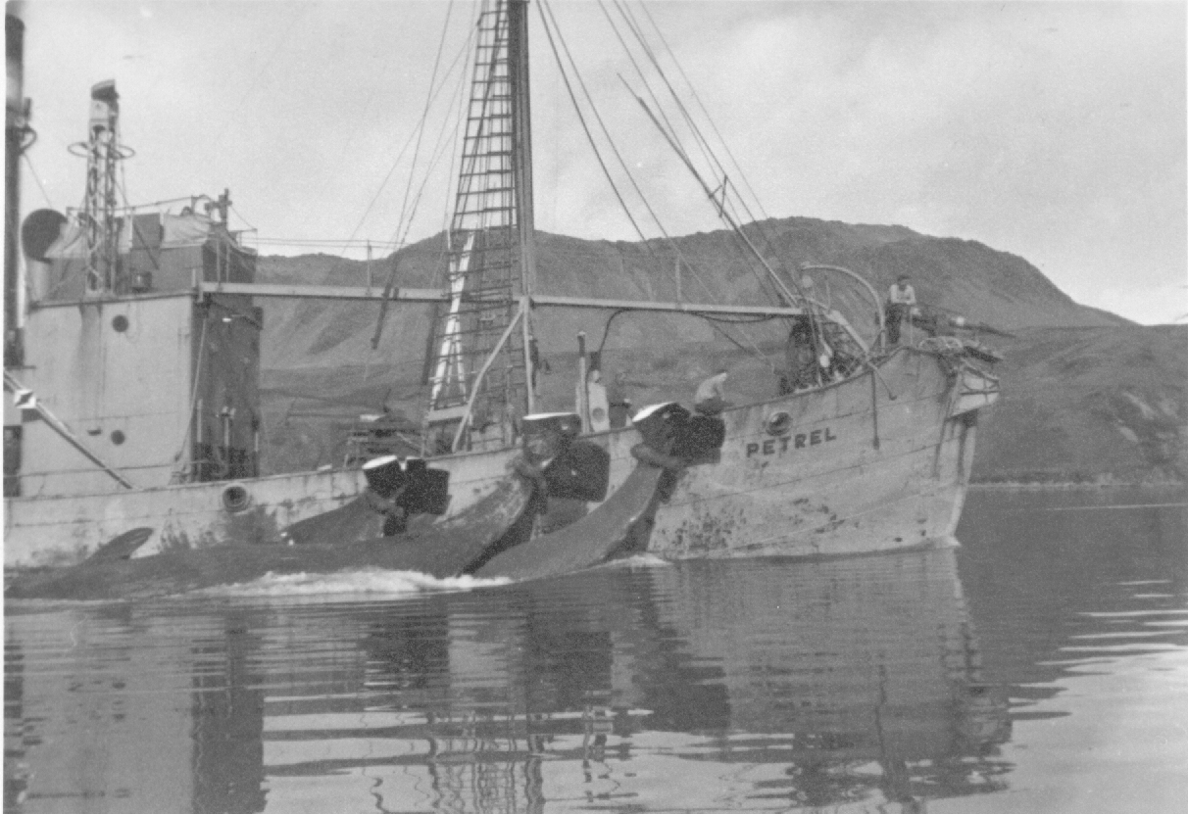
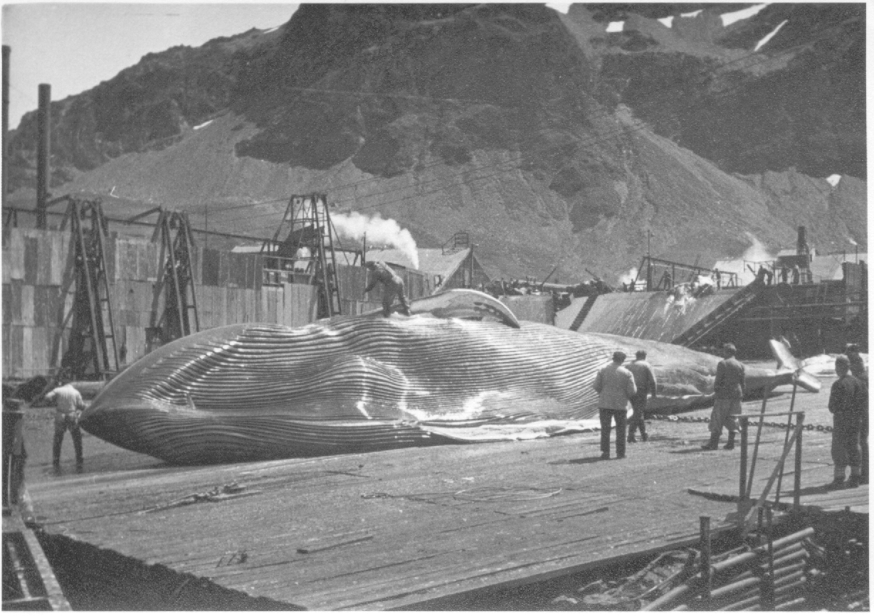
Southern Hemisphere
Cetacean Catch Totals
(1904-2000)
Blue 360,644
Fin 725,116
Humpback 208,359
Sei 203,538
Bryde 7,757
Minke 116,568
Right 4,338
Sperm 401,670
Other 11,631
Total 2,039,621
Clapham (2001)
Notes:
During the 20th century, whale populations in the southern ocean were so heavily depleted by commercial harvesting efforts that their current role in the Antarctic ecosystem is unknown.
And this table shows the number of animals taken by commercial whalers out of this ecosystem from 1904-2000
You can see that over 2 million whales were removed, which is a staggering number.
Many of these species were hunted to less than 1% of their pre-exploitation abundances
And are only now beginning to recover, if at all.

Slide 15
Advances in Cetacean Research
Model distribution in relation to environmental features/processes
Spatially explicit analyses of distribution, predictive habitat and utilization
Interdisciplinary
  Better understand and quantify environmental processes
  Finer sampling allows for better resolution across spatial scales
  Defining foraging habitat allows predictions of predator responses to environmental change
Notes:
Recent advances in cetacean research elsewhere have begun to model the distribution of whales in a more comprehensive and rigorous ways to environmental features and processes
This is being done with analytical tools which incorporate spatial structure and generate models of predicted habitat
There has also been a push towards more interdisciplinary research to:
Better understand and quantify environmental processes and how these affect cetaceans
Allow for finer sampling to better resolve processes across spatial scales
and to define foraging habitat to allow for predictions of predator responses to environmental change

Slide 16
Goals
Elucidate relationships between whales, concurrently measured environmental variables, and prey
Test specific hypotheses and explore how sympatric humpback and minke whales partition resources to avoid competition
Determine the ecological niches of sympatric krill predators
Begin to understand how single species and the relationships to other krill-predator species are likely to change with environmental variability
Develop novel research programs to study the foraging ecology of whales for comparison with other krill predators
Notes:
With this in mind,
The overall goal of this dissertation is to describe the spatial ecology of humpback and minke whales off the WAP and add to the body of work to establish linkages between oceanographic features, prey aggregations, and the distribution of baleen whales both in Antarctica and more generally.
I will use data from LTER and SO GLOBEC research programs to:

Slide 17
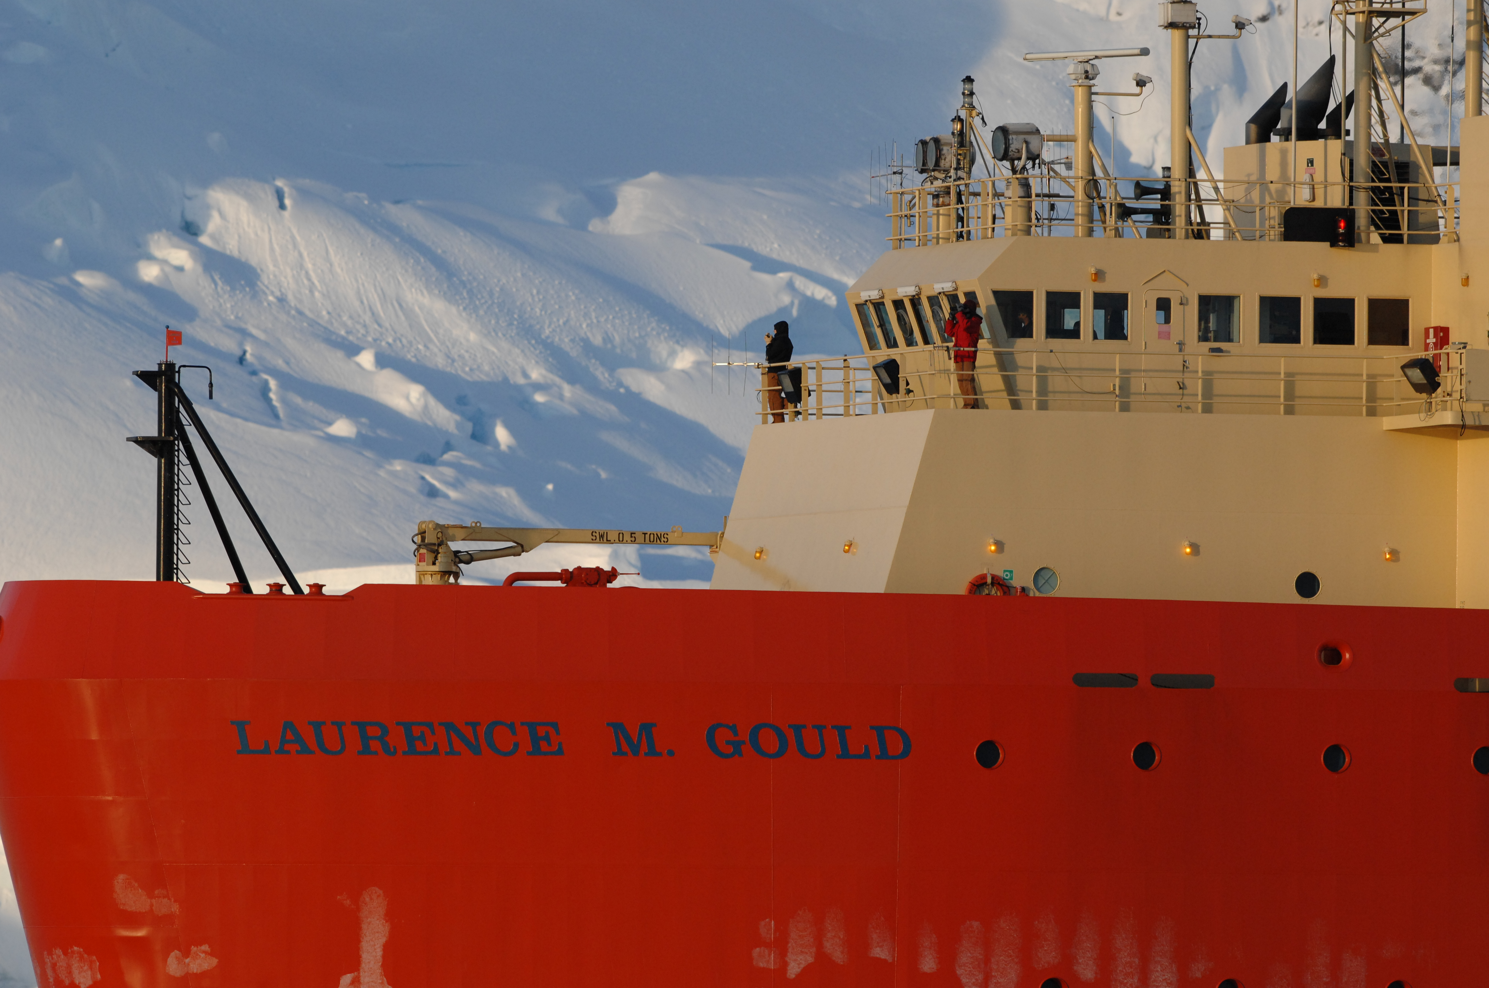
Step into my office

Slide 18
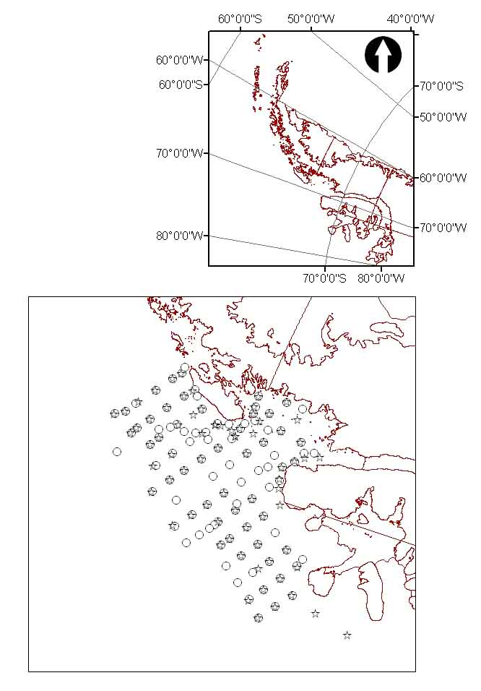
Environmental Data
Acoustic volume backscatter 25-100m (dB)
Acoustic volume backscatter 100-300m (dB)
Chlorophyll a
Bathymetry
Slope of bathymetry
Deep-water temperature maximum
Distance from coast
Distance from ice edge
Distance from high slope
Distance from inner shelf water boundary
Notes:
And concurrent to the visual sighting effort, we collected a suite of environmental data ranging from physical water mass measurements, to static bathymetric features, to along track acoustic measurements of volume backscatter which indicates zooplankton presence and abundance.
The zooplankton data come from the continuous recordings made with a towed 120kHz transducer.
The values we used were from averaged backscatter from 2.5km2 blocks centered around cetacean sightings.
The variables we used for our analyses are listed here and also include distance measurements from certain physical features
The locations indicated on the map show sampling stations

Slide 19
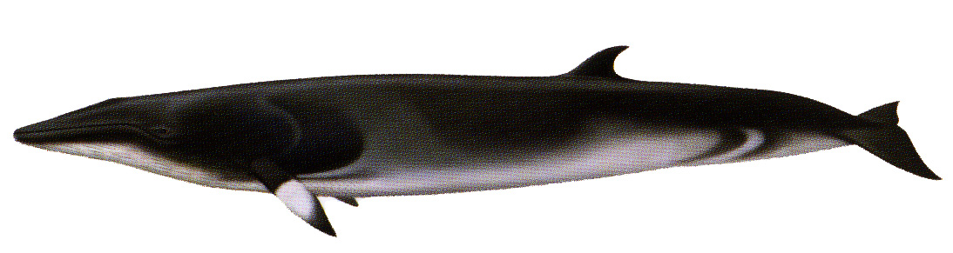
Statistical Tools
1. Spatial structure
  Ripley’s K
2. Relationships
  Mantel’s test
  CART, GAM
Environmental
factors
3. Predictive habitat models
  Classification and Regression Tree (CART)
  Logistic regression : probability of occurrence
  Geographic Information System (GIS)
Notes:
This figure shows the process to get towards the predictive habitat models
I will look for relationships between the distribution of cetaceans and the environment factors with a suite of regression models like tree-based, generalized additives and mantel’s tests
And with continued sampling we can use similar tools including GIS to build habitat envelopes and predictive habitat models to address issues in relation to how environmental variability and sea ice dynamics effect cetaceans

Slide 20
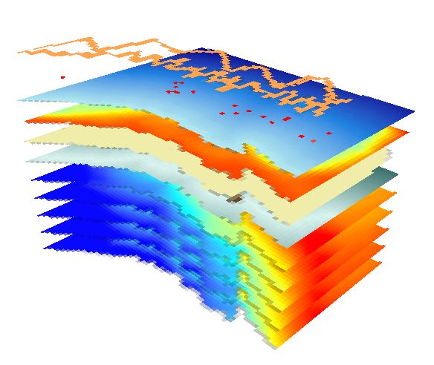
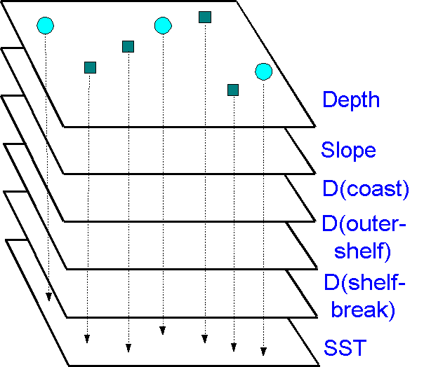
Analytical Methods
From GIS data layers to model samples…
Cruise transects
Whales
Sample points
vs. random points
Notes:
We used gis to create continuous surfaces of all of the environmental variables we are considering, either by generating distance matrices or interpolated grids from point sampled data like the deep water max. temp
We then broke down all of the visual surveys into 30 minute legs and sampled all of the environmental variables at each of these locations and then looked for relationships between the environmental variables and the number of baleen whales observed
I would also like to add that this slide created by pat halpin has now been used in 100 presentations and will be retired to the gis hall of fame

Slide 21
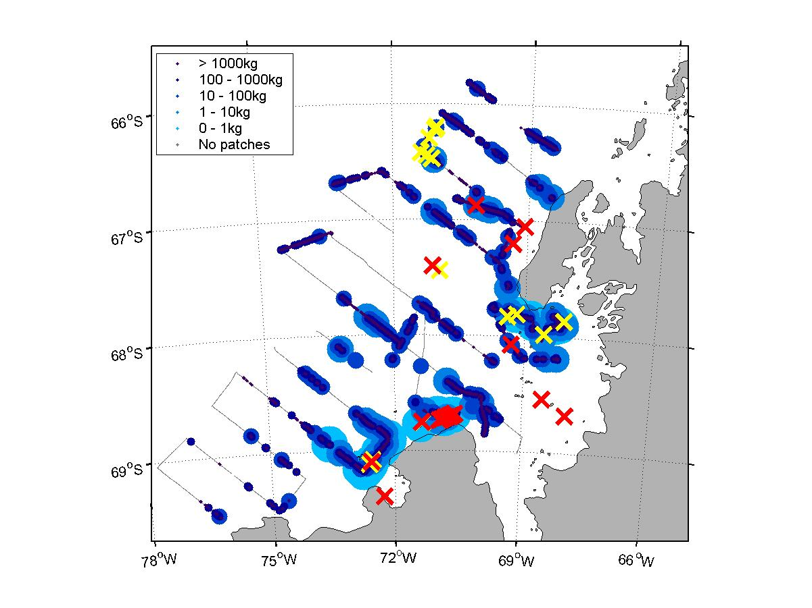
Spatial Relationships Between Whales and Environment
Notes:
Here is the overall pattern of where whales were observed, and where krill aggregations were measured
The size and biomass of aggregations are indicated by larger circles, and you can see overlap between areas of high krill biomass and whale sightings, yellows are humpbacks and reds are minkes
I then sampled each whale sighting location for krill patches within 5000, 2500, 1000, and 500 meters and summarized the variables for each sighting for each species and then compared the two samples

Slide 22
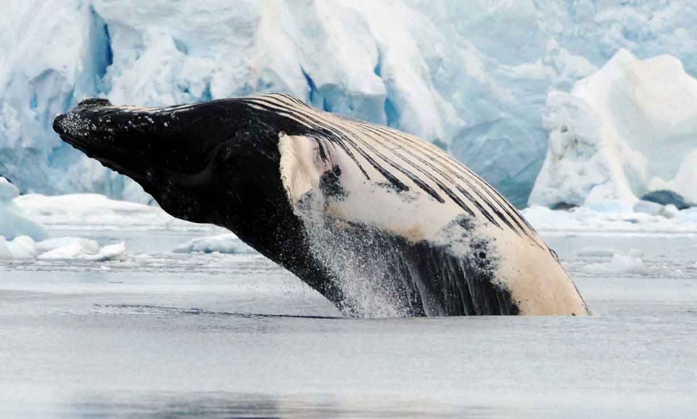
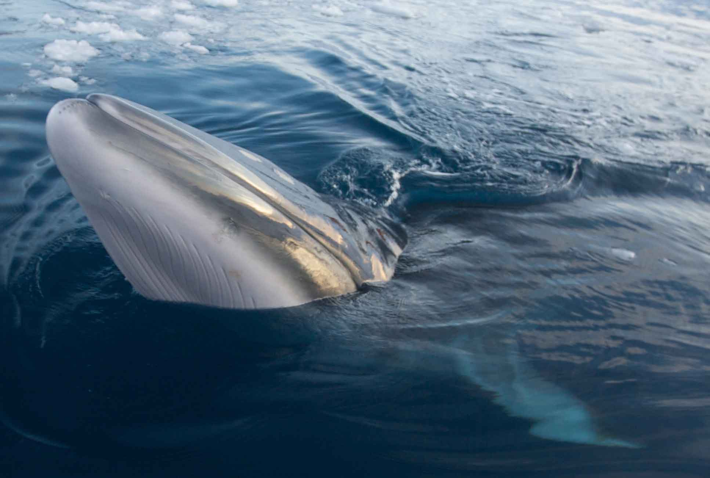
Humpback Whales:
Prey Abundance
Proximity to Shore
Bathymetric Slope
Minke Whales:
Sea Ice
Proximity to Shore
Prey Abundance
Friedlaender et al. 2006, 2008a,b

Slide 23
Resource Partitioning
Sympatric species must differ in their ecological niches to avoid competition
  Food preferences
  Biomechanics of body size
Smaller individuals with metabolic rate select higher quality and smaller food patches
Optimally, smaller animals should be more successful diving in shallow water, and larger animals should dive deeper
Notes:
Which leads to the second goal, regarding if and how sympatric humpback and minke whales partition resources to avoid inter-specific competition
Sympatric species, those with closely overlapping distributions, must differ in their ecological niches in some way to avoid competing for resources
Two mechanisms which commonly appear are differing food preferences brought on by the biomechanics of body size
smaller individuals with increased metabolic rates are known to select higher quality and smaller patches of food
In the north pacific, it was shown that minke whales feed on smaller patches of highly caloric fish than sympatric blue and fin whales which selected krill patches
And theoretical models show that optimally, smaller individuals should be more successful by diving in shallower water, and larger animals should dive deeper

Slide 24
Species-specific differences in krill patch depths
*P = 0.001 at all spatial scales
Friedlaender et al. 2008a
Notes:
When we compare the median depth of patches around minke and humpback whales we see a really interesting relationship.
At every spatial scale, from 5000 to 500 m, there is a significant difference in the median krill patch depth between minke and humpback whales
And, the differences between species gets larger the closer the patches are to the whales. Thus we get some indication of the environment around which these whales may be perceiving their prey.
What is really interesting though, and not expected, is that the minke whales are targeting deeper patches than humpback whales.
For patches within 500 meters of whales, humpback whales are targeting krill around 65 meters, and minkes are targeting krill around 100 meters deeper!
All the way out to 5000 meters, the separation between species is over 30 meters.
So this is really cool, humpback and minke whales appear to be partitioning resources vertically in the water column, and in an unexpected way.

Slide 25
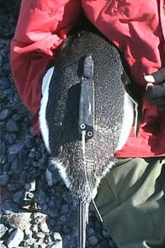
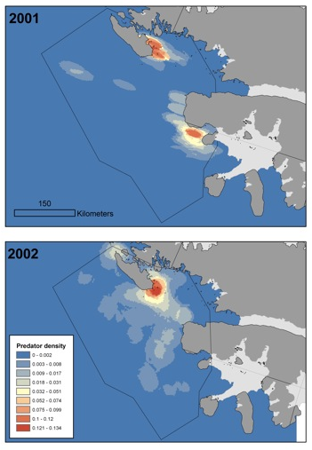
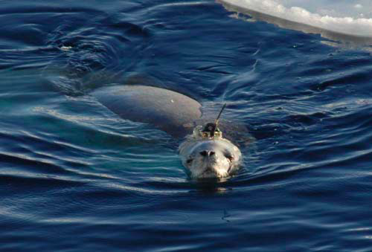
Krill Predator ‘Hot-Spots’
Penguinscience.com
Dan Costa
Friedlaender et al. 2010

Slide 26
Responses to Prey Availability
Change in distribution
Krill predators alter their demography
    e.g. reproductive rates
Changes in foraging behavior and fitness
    e.g. longer trip durations
Adelie penguin populations have decreased, Gentoos have increased
Notes:
While the mechanisms by which environmental variability affect sea ice cover and krill demography are being investigated, how these changes cascade to other ecosystem components such as apex predators remain poorly understood at all spatial and temporal scales.
Research does indicate changes in penguin foraging behavior and fitness in relation to prey and in some cases this also leads to population changes

Slide 27
Niche Theory and Competition
When animals with similar requirements, such as two or more closely related species, are found coexisting in the same area, careful analysis usually indicates that they are not actually competing with each other
  Lack 1954, MacArthur 1958, Connell 1961
    For closely related sympatric species to coexist, they must differ to some degree in their ecological requirements or niches (e.g. diets) to avoid inter-specific competition
      Pianka 1974, Schoener 1983

Slide 28
Ecological Niches and Competition
    In order to demonstrate that competition exists, the species in question must be shown to be:
      resource limited (Milne 1961),
      have substantial spatio-temporal overlap in their distribution,
      and must occupy similar ecological niches. The former is predicated on having similar prey types (e.g. age class of common prey item),
      as well as foraging in similar physical levels (e.g. patch depth, size, etc.)

Slide 29
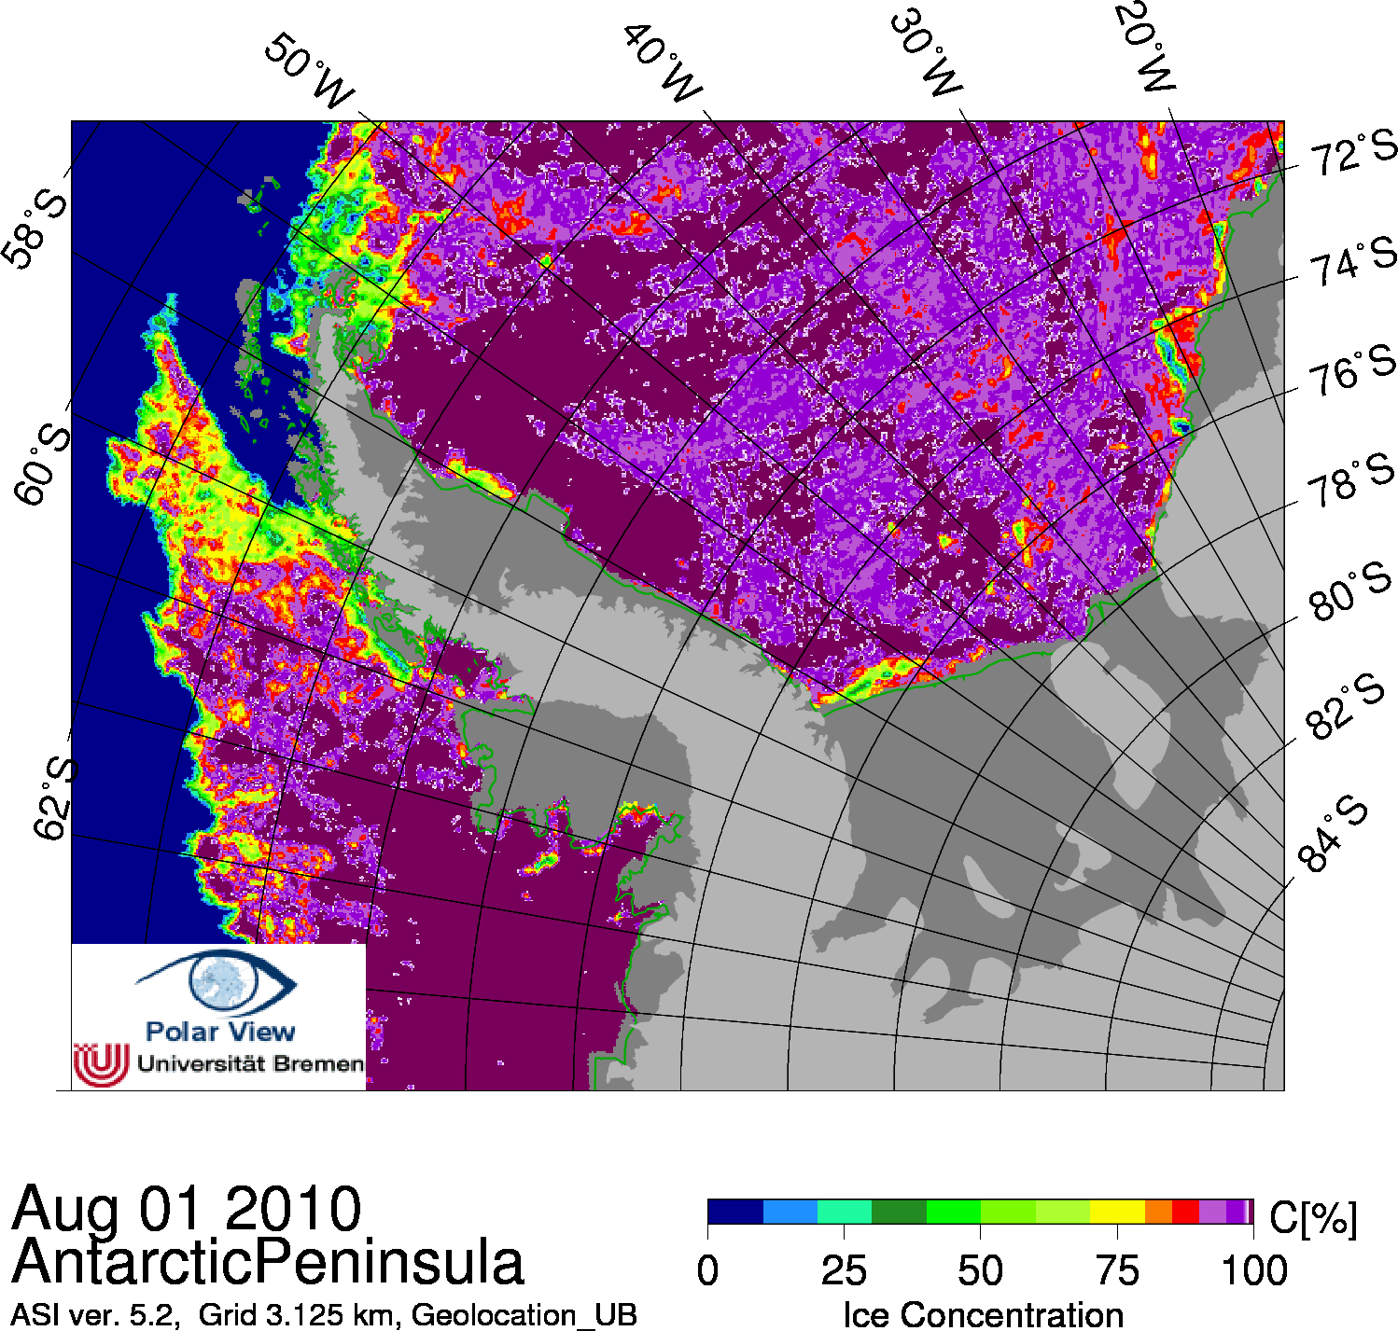
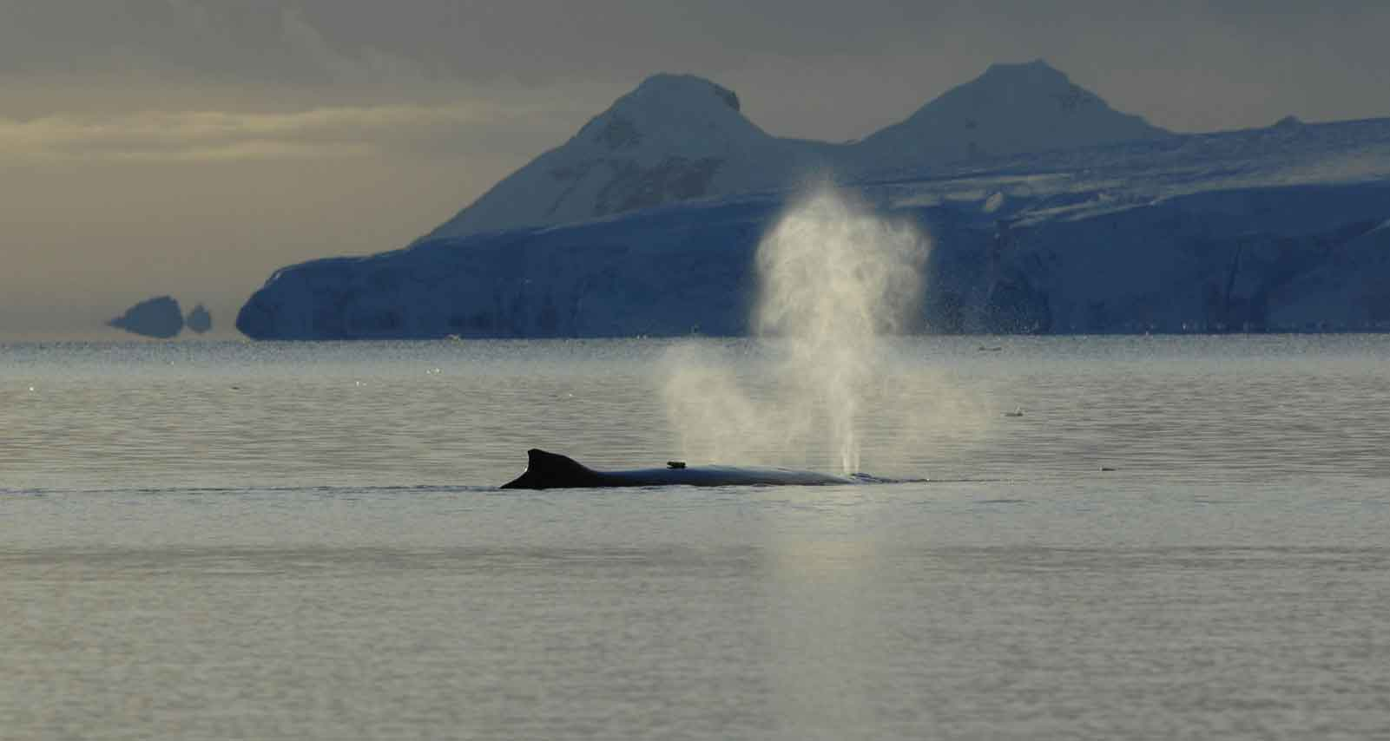
Ecological Niche Modeling
Variables include:
sea ice cover
prey biomass
depth
SST, deep temperature
proximity to shore

Slide 30

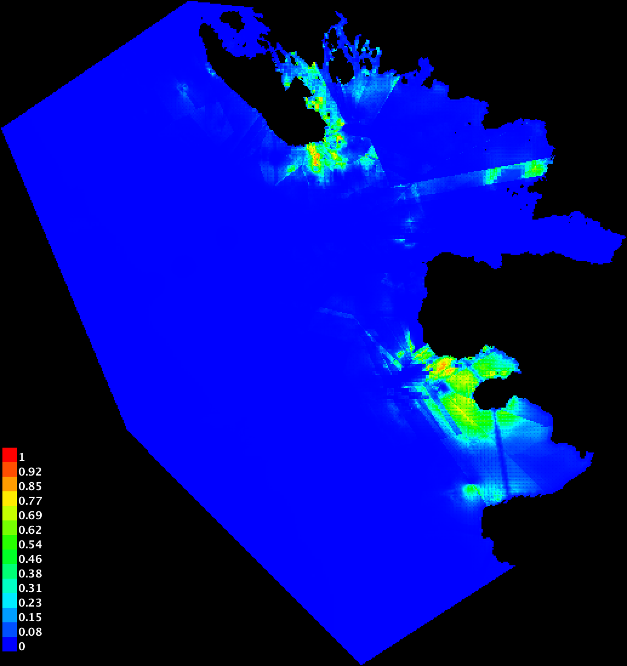
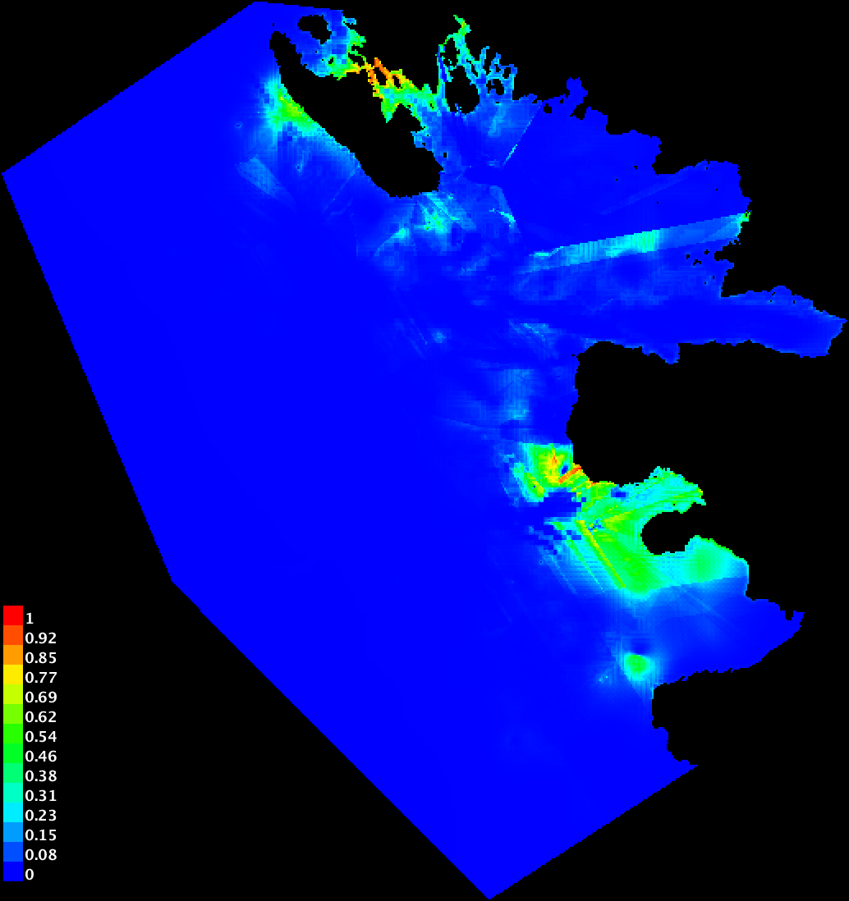
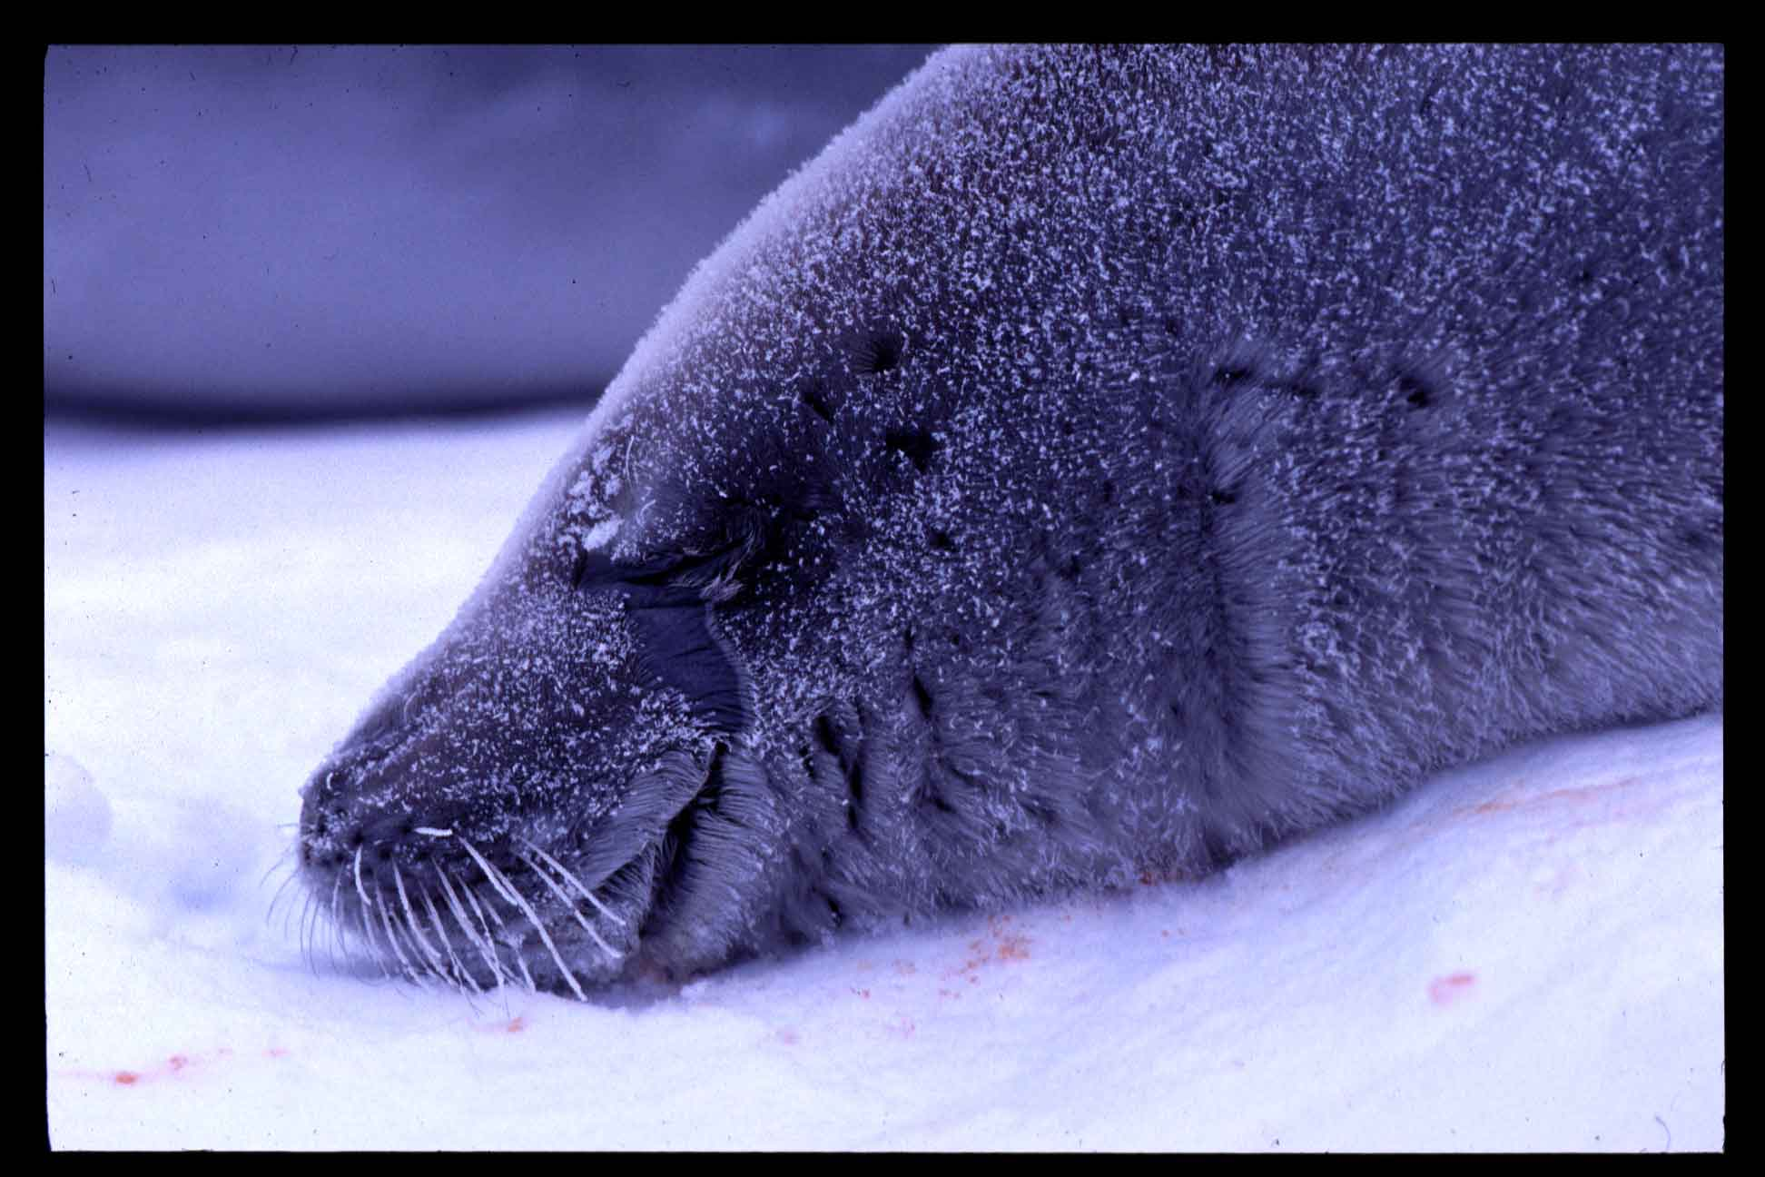
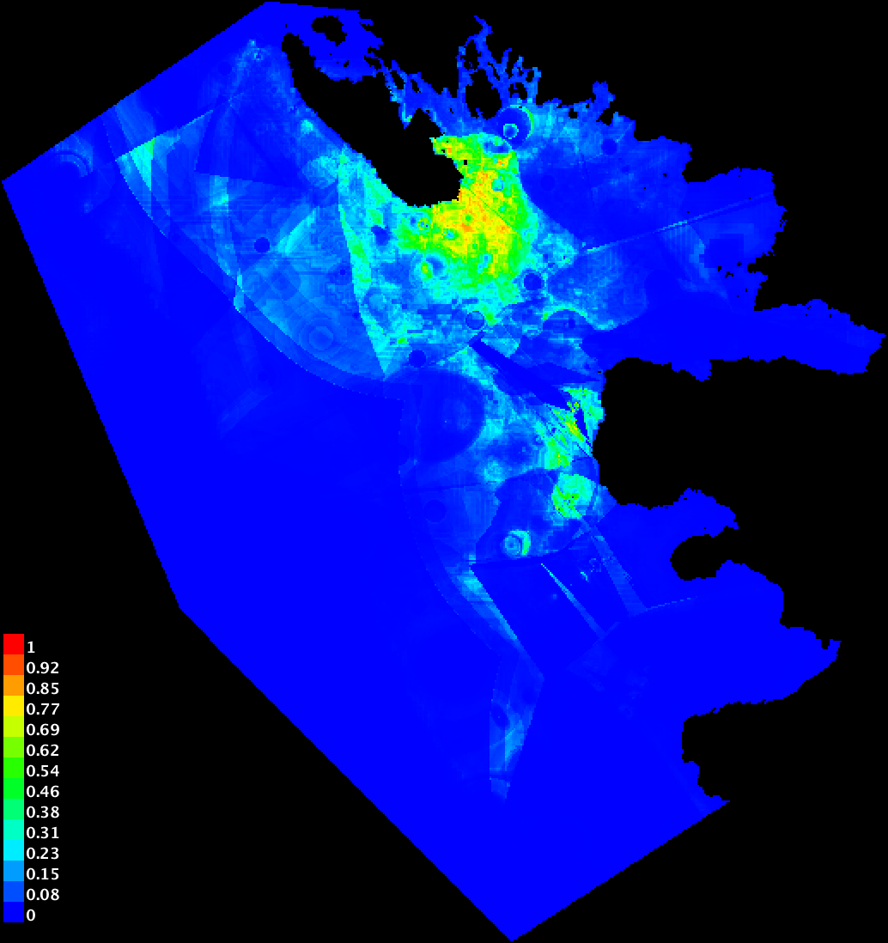
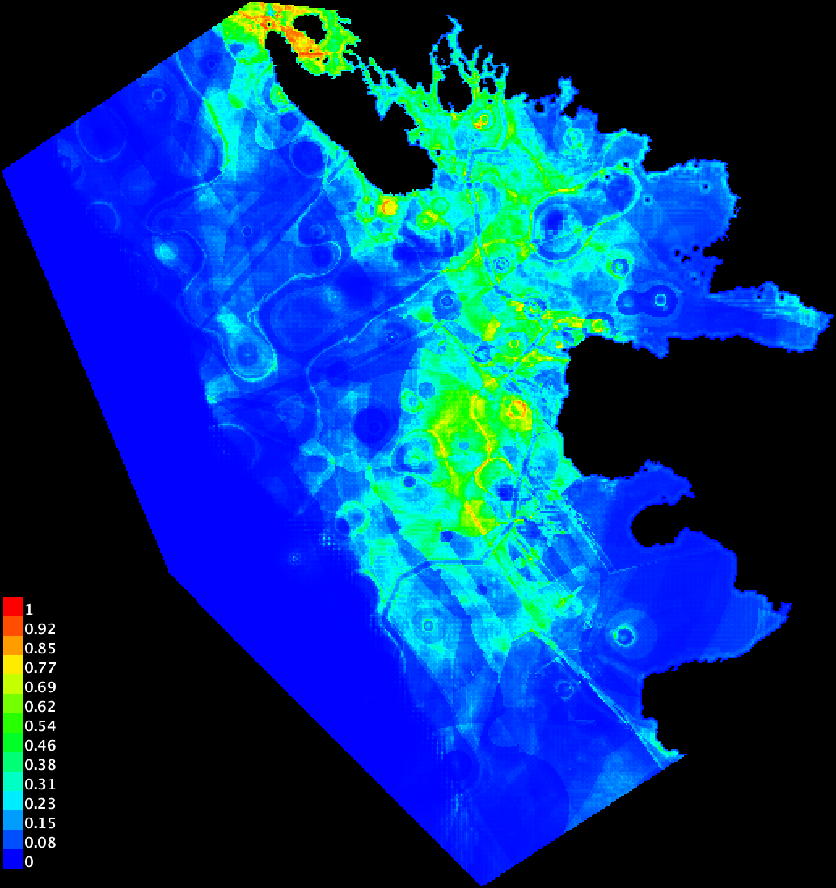
Predicted Suitable Habitat
2001
2002

Slide 31
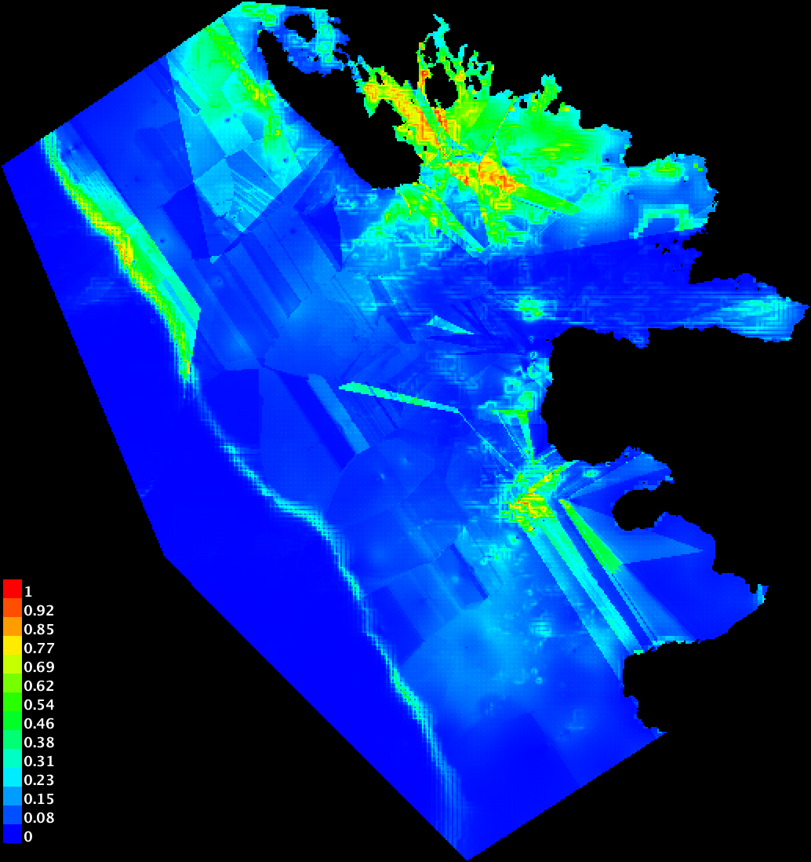
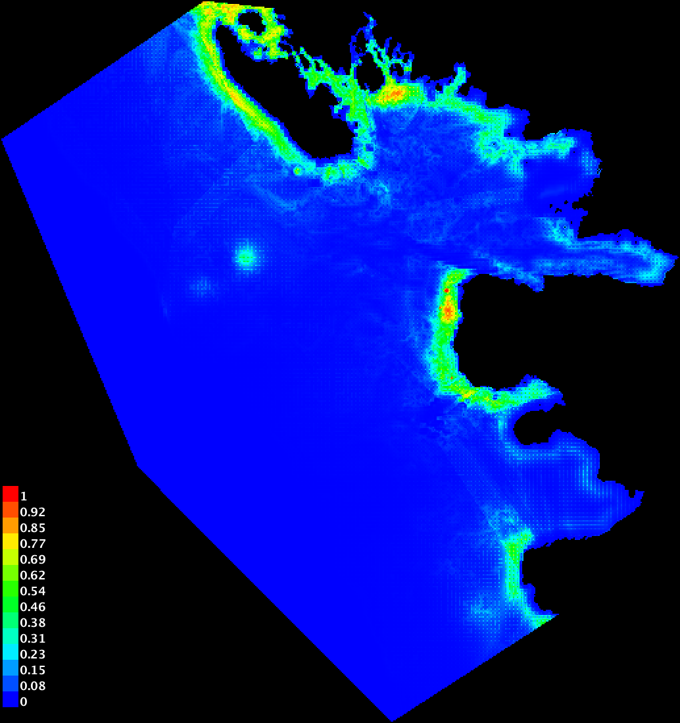
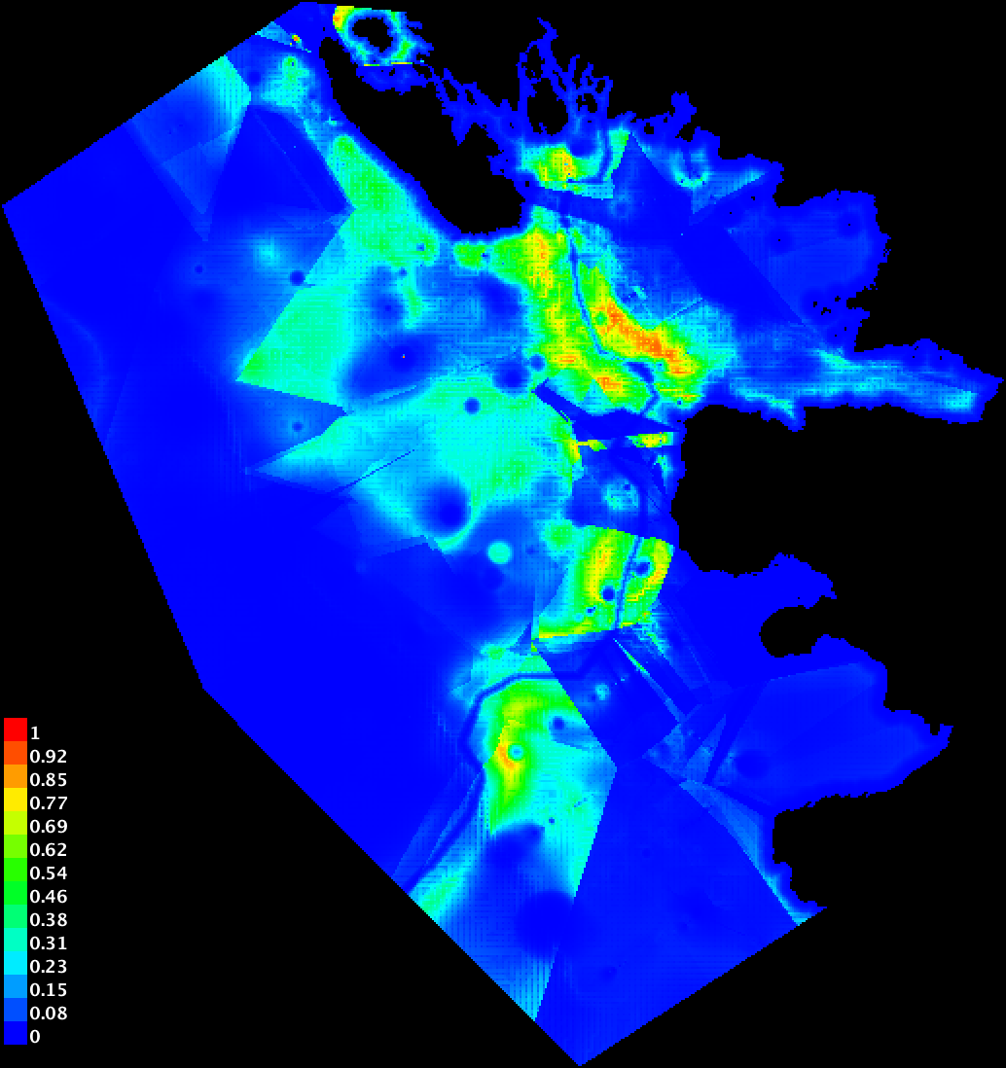
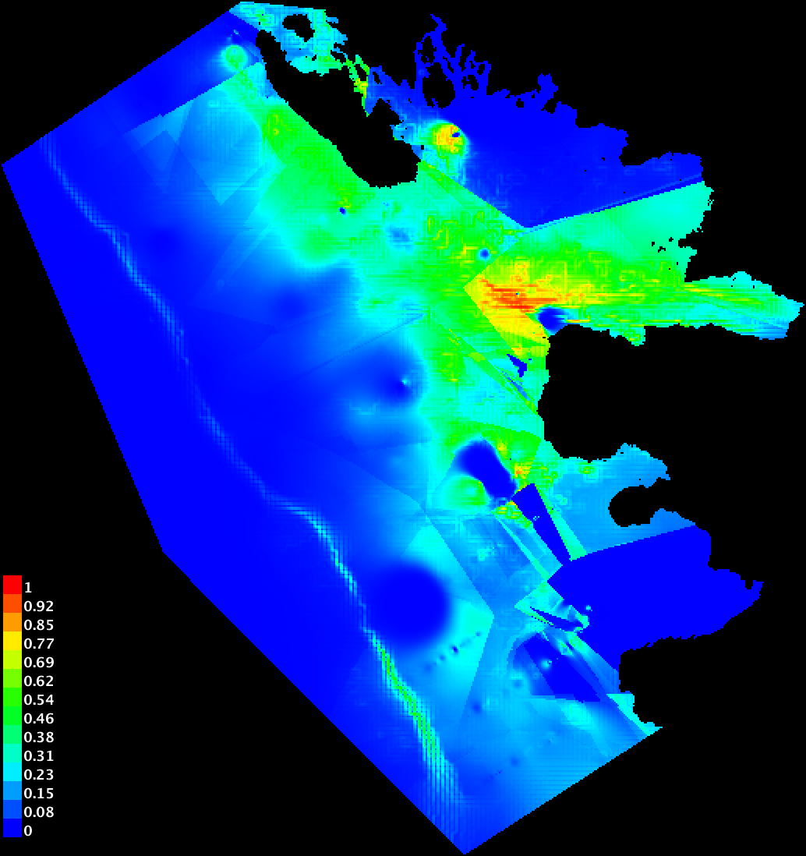
Predicted Suitable Habitat
2001
2002

Slide 32
Ecological Niches
2001
Coast
Depth
Prey (top)
Coast
Ice
Prey (bottom)
Prey (bottom)
Ice
Depth/Shore
Coast
Ice
Prey (bottom)
2002
Ice
Coast
prey
Ice
Slope
Chl_a
Prey (top)
Ice
Tmax
Coast
Ice
Prey (bottom)

Slide 33
Niche Overlap Between Krill Predators: 2001

Slide 34
Niche Overlap Between Krill Predators: 2002

Slide 35
Interannual Sea Ice Variability
Charlotte Bay
2008
2009

Slide 36
Interannual Niche Overlap, 2001-2002

Slide 37
Ecological Summary
Consistent krill predator ‘hot spots’
Adelie penguins and Crabeater seal habitat: physical features/substrate
Cetacean distribution: prey
Niche stability: cetaceans > penguins, seals
High niche overlap between humpback and minke whales
  Less overlap in prey size preference
  Decrease competition
Low niche overlap between whales and penguins
  Higher overlap in prey size preference
  Potential for increased competition with certain conditions

Slide 38
WAP Sea Ice Change: Summary
Negative trends in ice cover, duration, formation
    Regional and Bay scale
    80 fewer days of ice cover annually
Gerlache Strait remains relatively ice free
    Compared to areas south, and adjacent bays
    Negative trend in ice cover and timing

Slide 39
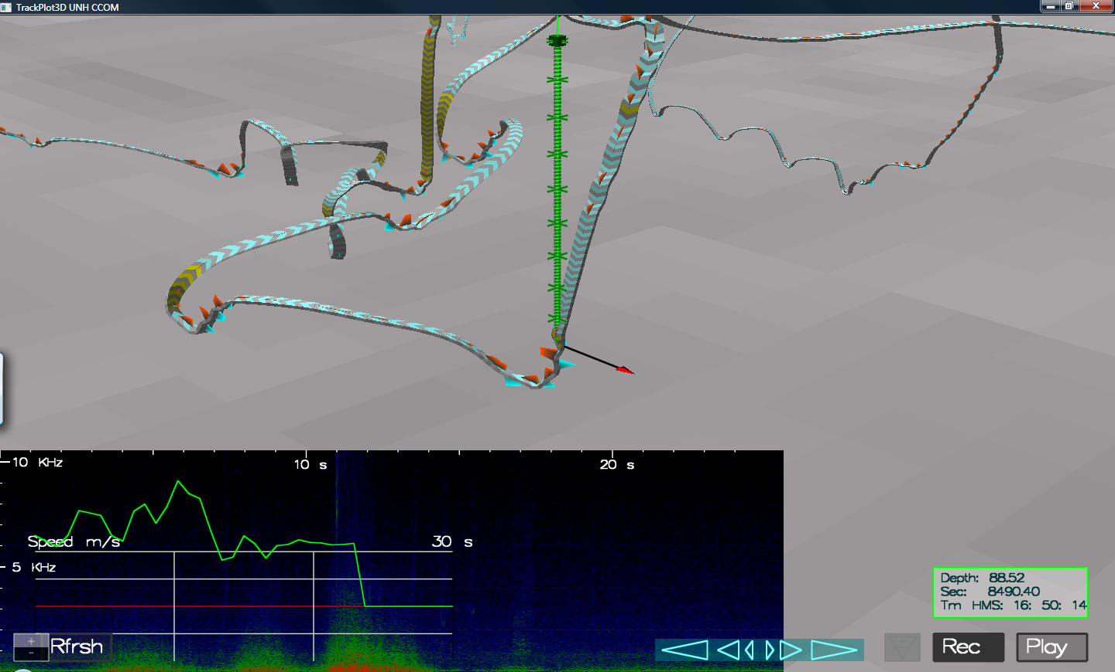
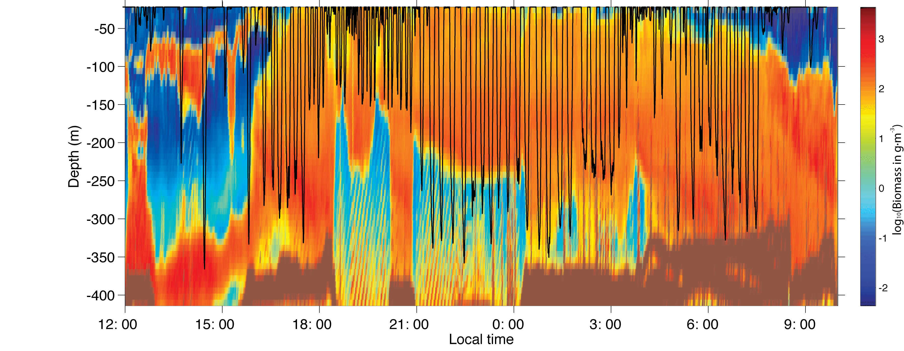
Next Steps
- Focused tagging work across taxonomic groups
- Determine actual prey preferences
Vertical resource partitioning
Regional differences in krill requirements

Slide 40
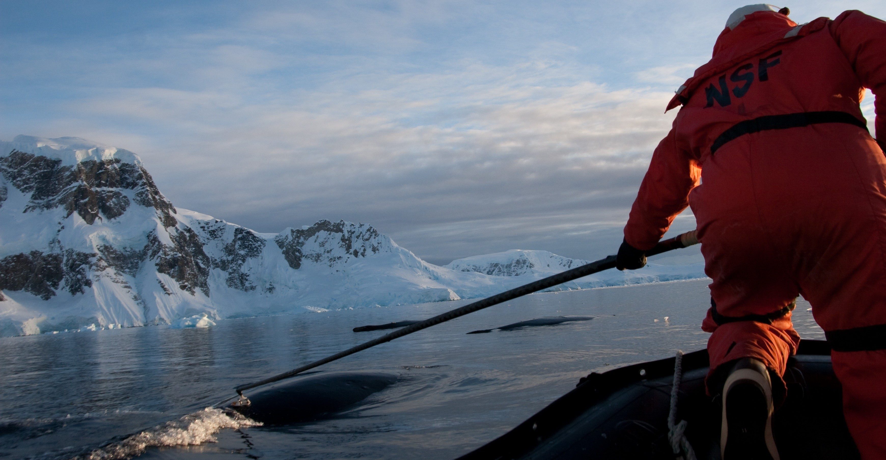
Multi-scale Interdisciplinary Study of Humpbacks And Prey

Slide 41
Conclusions
Krill may be greatly affected by changes in sea ice
  Decreased habitat
  Increased predation pressure
Krill predators are being affected by climate driven changes
  Ecological niches
  Potential for competition between taxonomic groups
Understanding individual foraging behavior from tag data will:
  elucidate ecological interactions between predators-prey
  Allow for comparison across predators

Slide 42
Conclusions
Krill predator hot-spots exist throughout the WAP
Species composition changes with changing ice cover
Ecological niches differ between predators and between years
Potential for competitive interactions exists
Ability to measure foraging behavior and feeding rates concurrent with measurements of prey is paramount

Slide 43
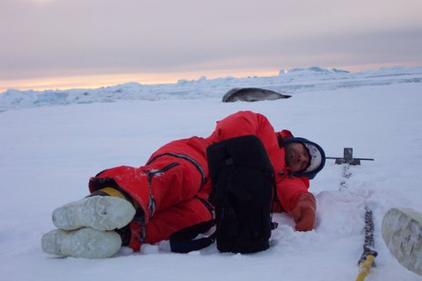

Slide 44
