Slide 1
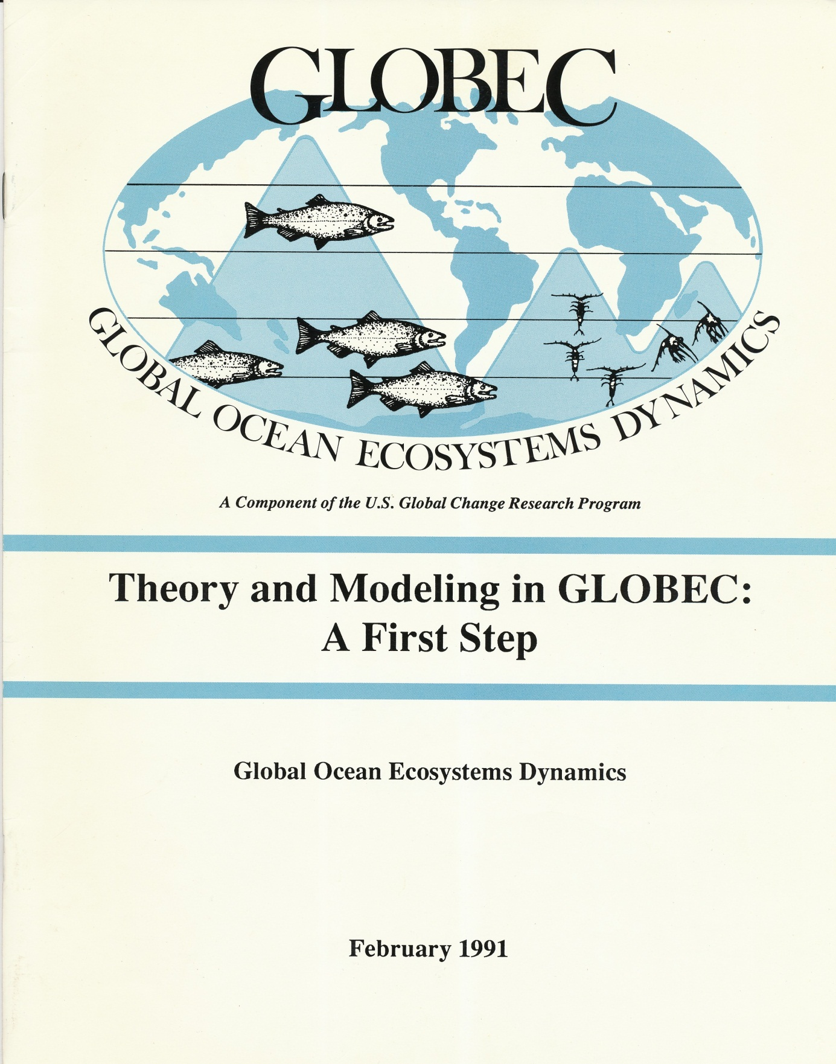
Two decades of progress in physical-biological modeling and prediction

Slide 2
“We have identified three broad categories that are critical to explore:
  conceptual studies of simplification and predictability
  prototype investigations of biological processes in idealized flow fields
  site-specific models.”
E. Hofmann, T. Osborn, T. Powell (chair),
J. Price, B. Rothschild, J. Roughgarden

Slide 3
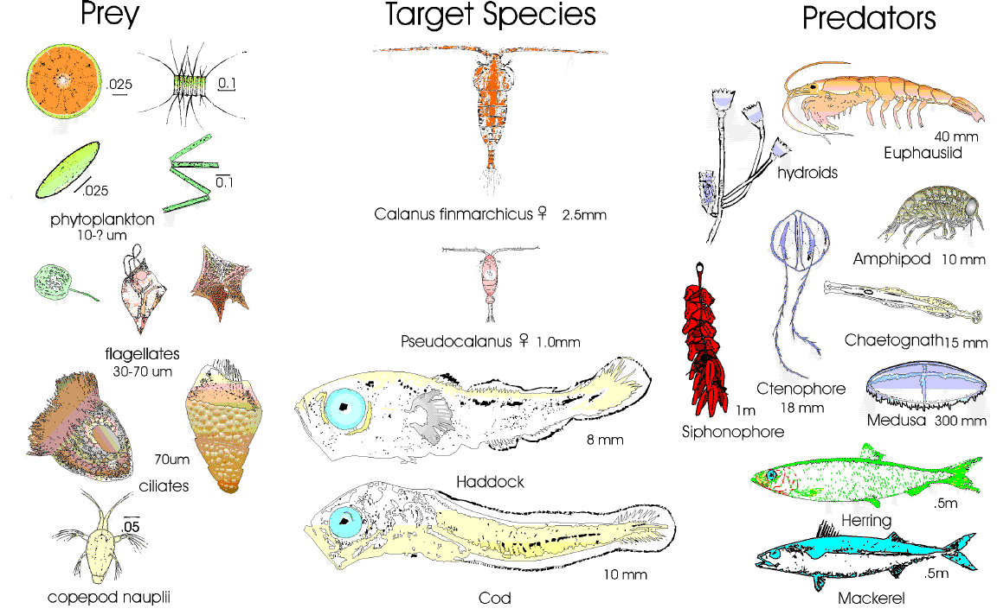

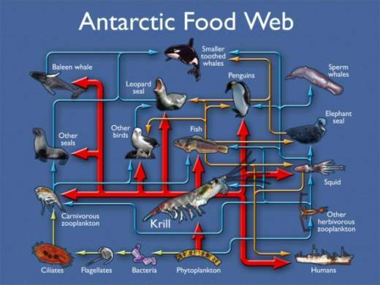
(1) Conceptual studies of simplification and predictability
Northwest Atlantic
Northeast Pacific

Slide 4
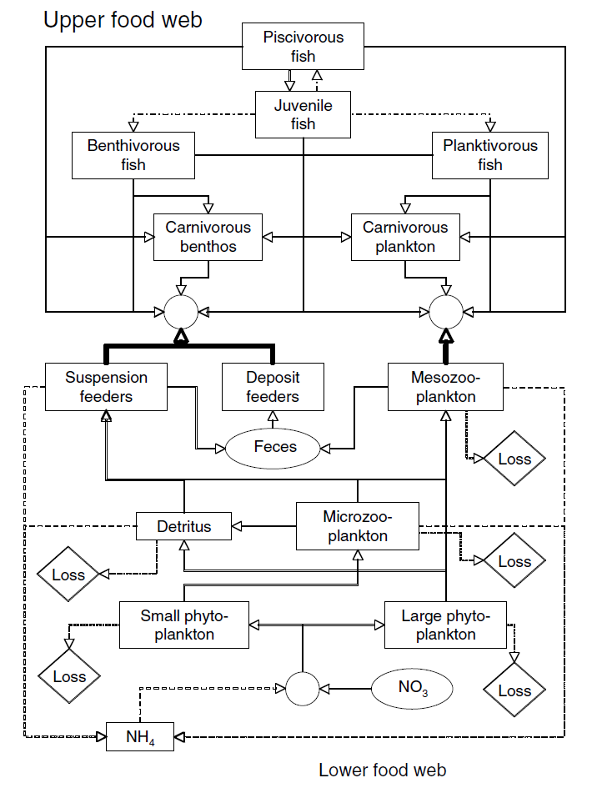
End-to-end ecosystem analysis: Do top-down and bottom-up productivity estimates agree?
Upper food web
?
Lower food web
Nutrient supply
Steele et al. (2007) Progress in Oceanography 74, 423-448. U.S. GLOBEC Contribution 519.
Notes:
Upper food web: forced by observed fish abundance, gut contents

Slide 5
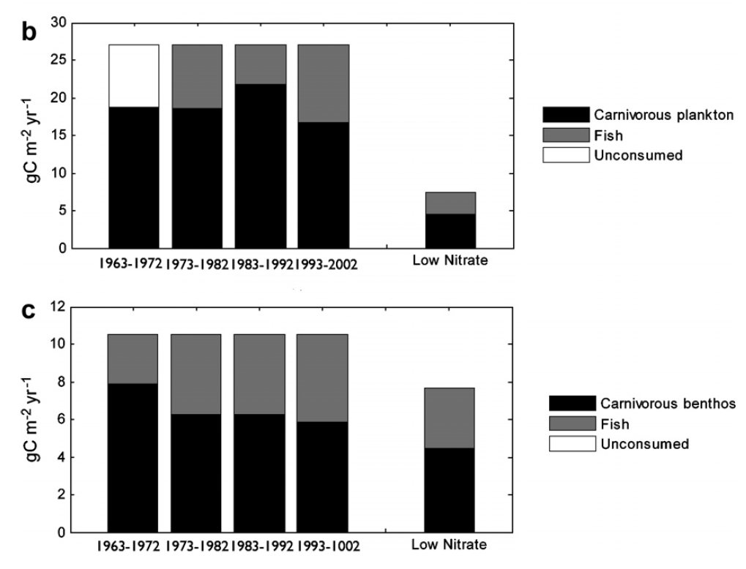
To first order, the answer is yes.
Zooplankton
production
Benthic
production
Steele et al. (2007) Progress in Oceanography 74, 423-448. U.S. GLOBEC Contribution 519.

Slide 6
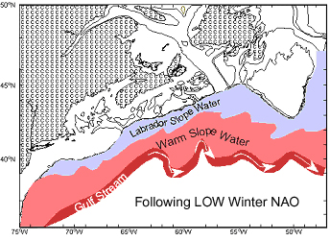
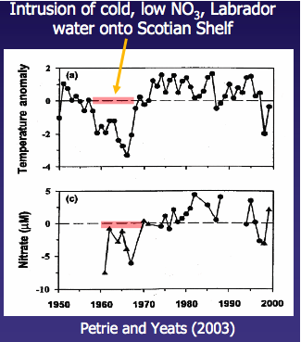
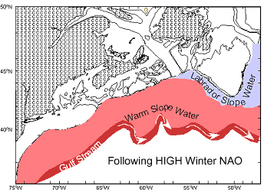
North Atlantic Oscillation: Labrador Slope Water Intrusions Reduce Nutrient Supply to the Region
Drinkwater et al.
LSW: low nutrients
WSW: nutrients 50% higher

Slide 7
End-to-end models reveal interdecadal variations in ecosystem structure and productivity
Zooplankton
production
Benthic
production
Steele et al. (2007) Progress in Oceanography 74, 423-448. U.S. GLOBEC Contribution 519.
Notes:
Taking into account the low-nitrate water characteristic of the 1960s, top-down and bottom-up models can be brought into agreement. The solution is one in which benthic production is slightly lower and drastically reduced zooplankton production. Thus this end-to-end approach yields interdecadal variations in ecosystem structure and productivity– a major milestone.

Slide 8
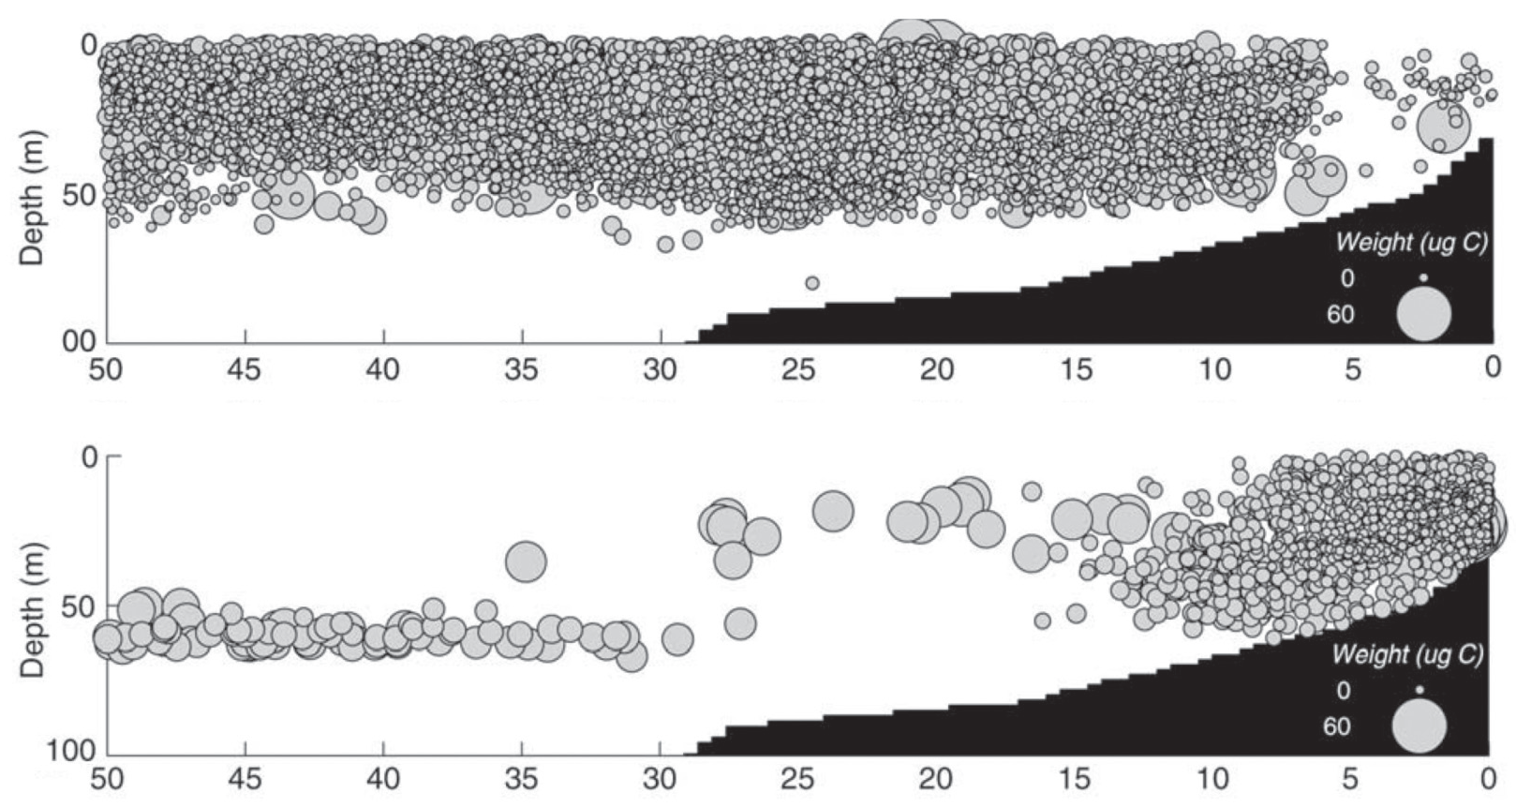
(2) Prototype investigations of biological processes in idealized flow fields
A lagrangian ensemble individual based model of copepods in an upwelling system
Without vertical migration
With vertical migration
Distance offshore (km)
Batchelder et al. (2002) Progr. in Oceanogr. 53, 307-333. U.S. GLOBEC Contribution #201.
Notes:
Circle size – weight
Upwelling system – without DVM advection lowers abundance in nearshore region
With DVM copepods are retained in nearshore area, grow larger
Larger copepods exported offshore seek the DCM
Two different results for a coastal upwelling simulation. The upper panel shows the
copepod distributions after 40 days for a simulation in which there is no copepod diel vertical
migration. In the lower panel, there is copepod vertical migration with the speed dependent
on light, food concentration, the individual’s weight, and hunger. Bubble size is related to individual
copepod weight. The horizontal axis shows the distance from shore in kilometers.

Slide 9
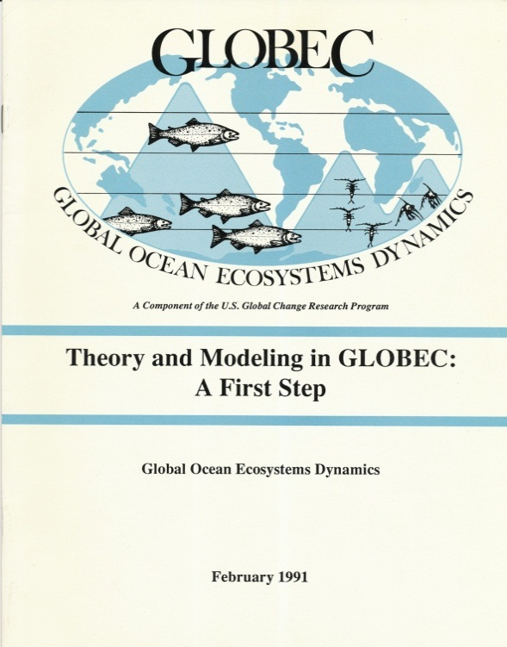
(3) Site-specific models
Examples from U.S. GLOBEC Study Sites
  Southern Ocean
  Coastal Gulf of Alaska
  California Current System
  Northwest Atlantic

Slide 10
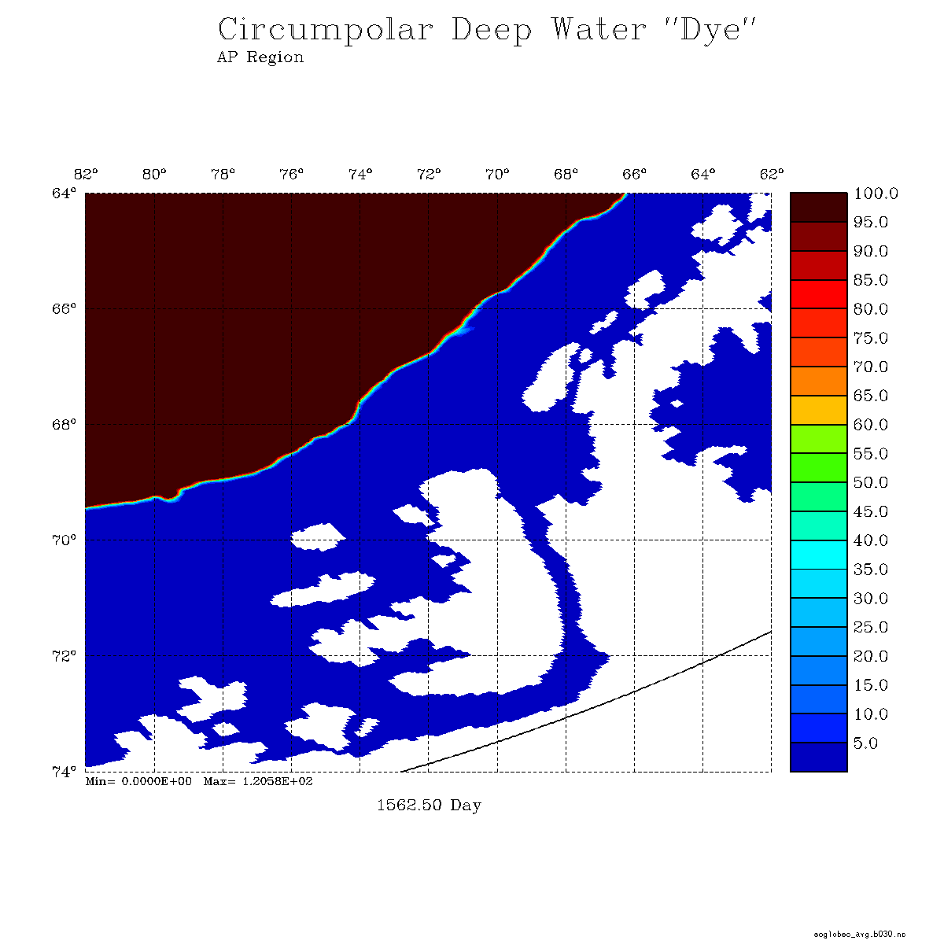
Southern Ocean – West Antarctic Peninsula
Penetration of circumpolar deep water onto the shelf
West
Antarctic
Peninsula
Alexander
Island
Dinniman et al. (2011) Deep-Sea Research II 58, 1508-1523. U.S. GLOBEC Contribution 691.
Notes:
CDW warm and nutrient-rich:
importance to heat flux and ice balance
nutrients – macronutrients and trace elements like Fe
Bathymetrically steered pathways
Intermittent pulses, some of which may be related to wind
Mesoscale structure
1200 slow. Note the large path through Marguerite trough into the cavity under GVI. Also CDW coming in from Ronne Entrance. Mention other two intrusions.

Slide 11
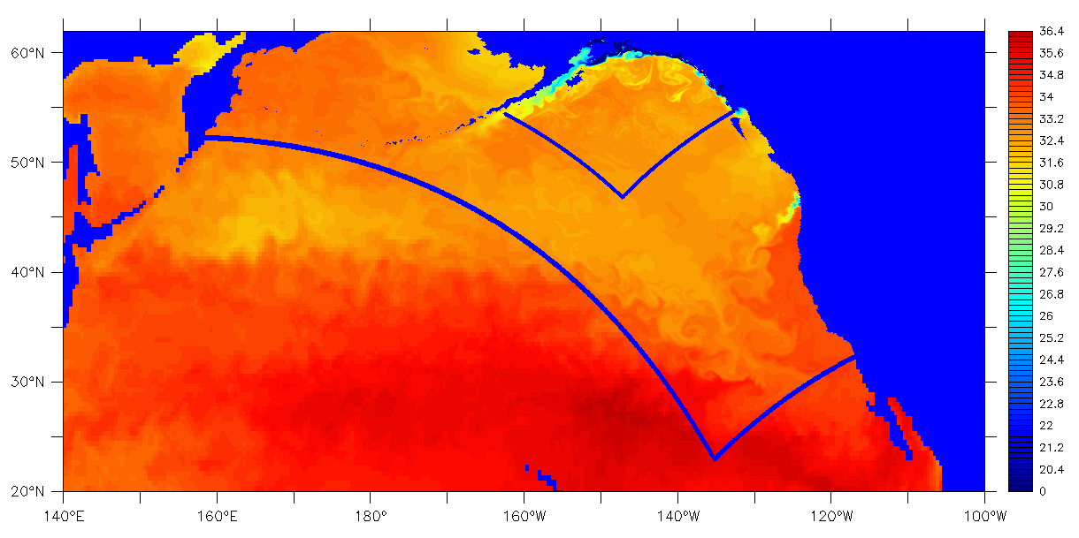
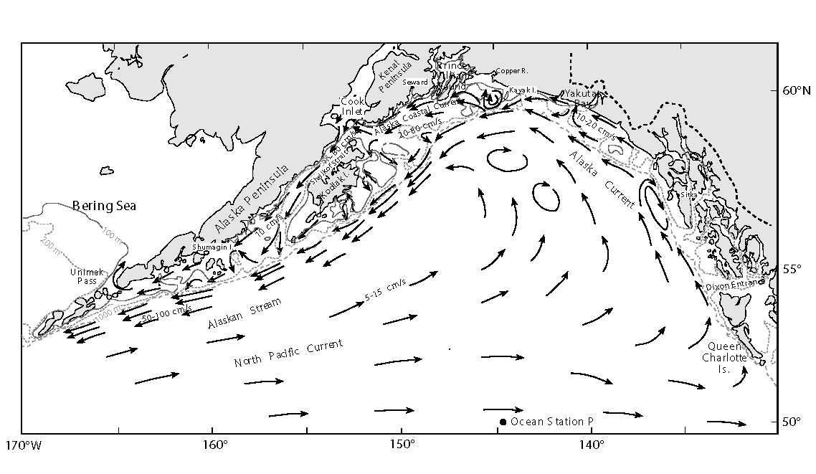
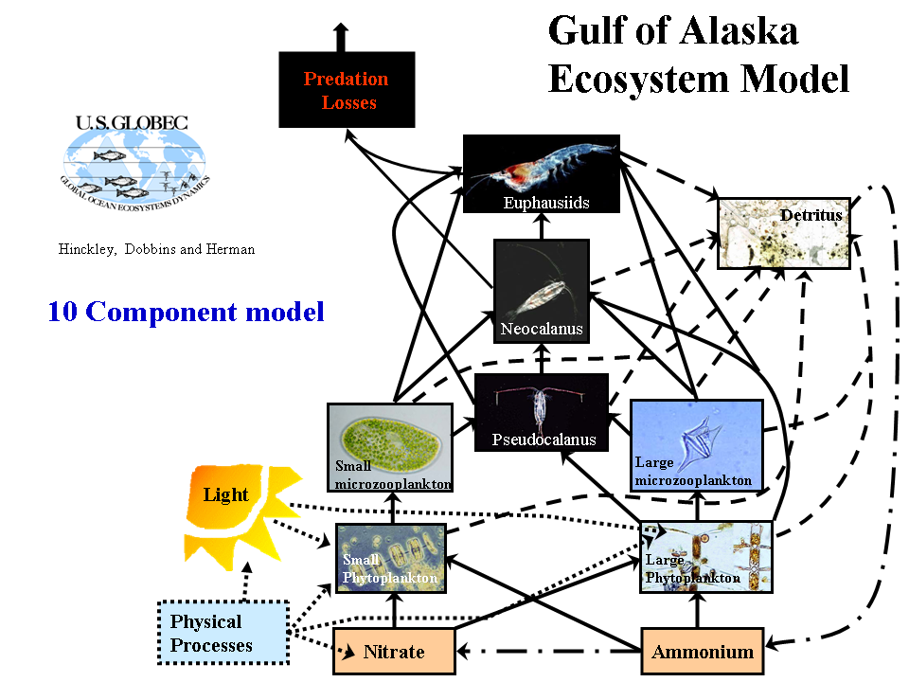
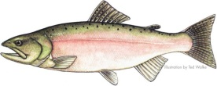
Coastal Gulf of Alaska
Salinity
Al Hermann
Notes:
CGOA: enormously productive ecosystem in a region of downwelling-favorable winds – how does it work?
Realistic simulation – nested models
high resolution of mesoscale features
representation of the large scale forcing of the system
N.B. the word “nesting” does not appear in Report zero

Slide 12
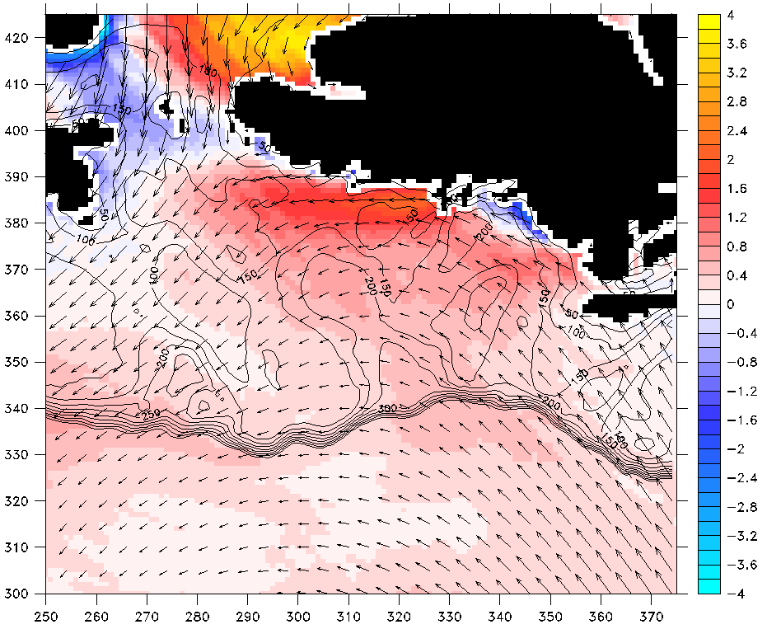
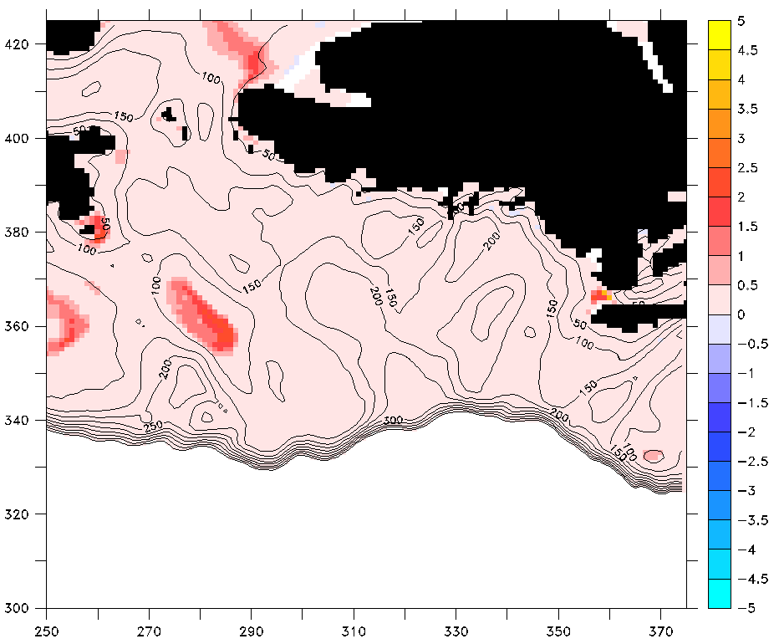
Why is the CGOA so productive despite being subject to mean winds that are downwelling-favorable?
Upwelling driven by curl of the wind stress
Tidal mixing
May 2001
May 2001
Wind stress (vectors) and curl (N m⁻³ x 10³)
Vertical diffusion (mmol N m⁻² s⁻¹ x 10³)
Hermann, A.J. et al. (2009) Deep-Sea Research II 56, 2474-2486. U.S. GLOBEC Contribution 629.
Notes:
Mean winds: vectors; downwelling favorable, suppressing productivity
Wind stress curl: color shading; promotes upwelling, model indicates a substantial nutrient flux
Nutrient fountains: tidal mixing over shallow banks (common theme GB)

Slide 13
(3) Site-specific models
U.S. GLOBEC report 0:
“We propose that the first step in the GLOBEC program should be a modeling effort to determine how well we are able to put together our present knowledge of physical oceanography with the known population biology of marine organisms that have numerous, distinct, planktonic life stages. There have been few, if any, theoretical models that have successfully addressed this question…”

Slide 14
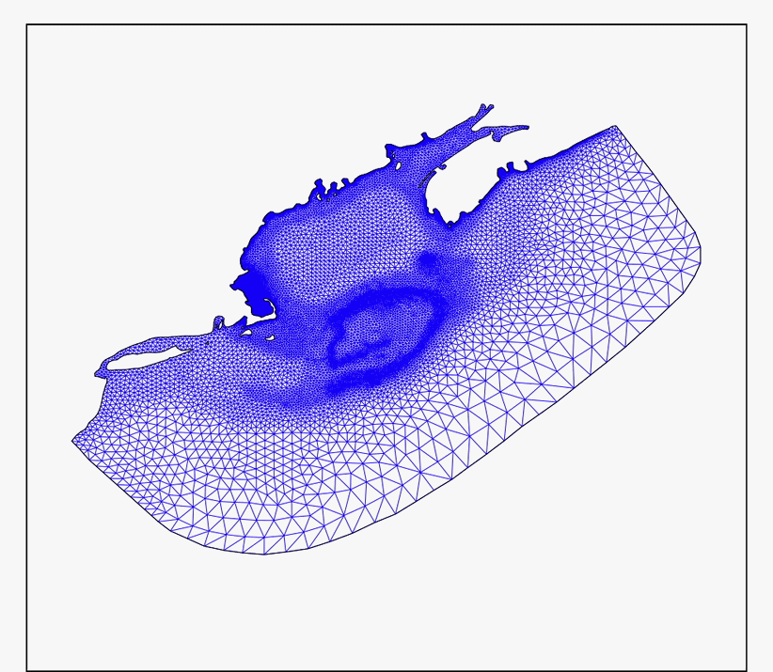
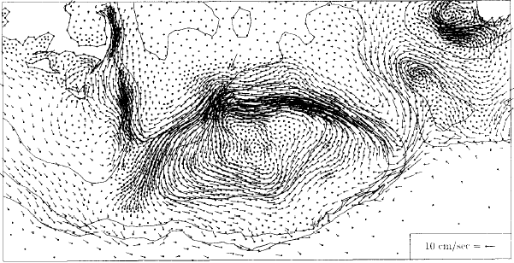
Application of unstructured meshes in GLOBEC modeling studies of the Northwest Atlantic
FVCOM
Lynch et al. (1996) Continental Shelf Research 16 (7), 875-906. U.S. GLOBEC Contribution #77
Chen et al. (2006) Journal of Geophysical Research 112, C03018. U.S. GLOBEC Contribution #294
Notes:
Unstructured meshes as an alternative to nesting
Lynch, later Chen with FVCOM
Regional scale model, but high resolution where it is needed

Slide 15
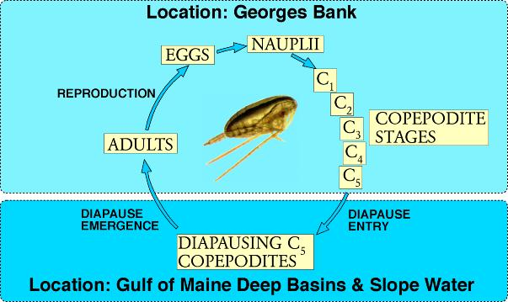
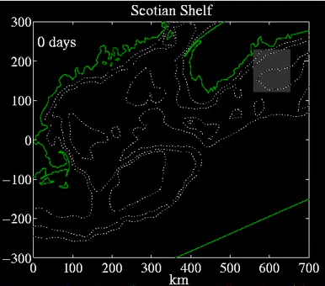
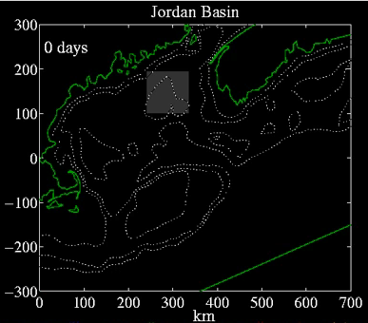
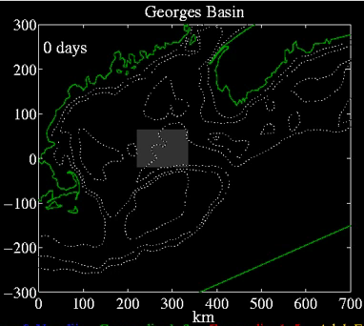
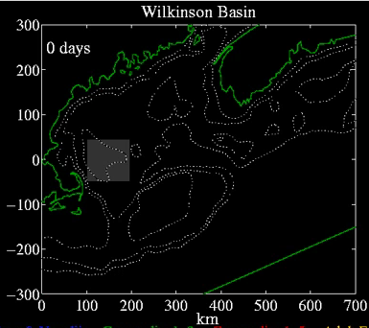
Individual-based models of C. finmarchicus: effects of different source populations
Mark Benfield
Eggs/Nauplii
Copepodite 1-3
Copepodite 4-5
Adult Female
Miller et al. (1998) Fisheries Oceanography 7(3-4) 219-234. U.S. GLOBEC Contribution #101
Notes:
Life history of C.f.
Simulation of 2 generations from key source areas
Western gyres seed the crest; Georges Basin and Scotian shelf seed NE peak
Advection is a key aspect of the oceanographic ecology of the organism; Jeff Runge will return to this aspect.

Slide 16
“We have identified three broad categories that are critical to explore:
  conceptual studies of simplification and predictability
  prototype investigations of biological processes in idealized flow fields
  site-specific models.”
E. Hofmann, T. Osborn, T. Powell (chair),
J. Price, B. Rothschild, J. Roughgarden

Slide 17
Data assimilation
U.S. GLOBEC report 0:
“The incorporation of data into models is a critical topic that needs to be addressed early by any modeling attempt…This effort might assess the usefulness of the formal techniques of data assimilation. These newer approaches have not been applied in biological models, whether coupled to the physical environment or not.”

Slide 18
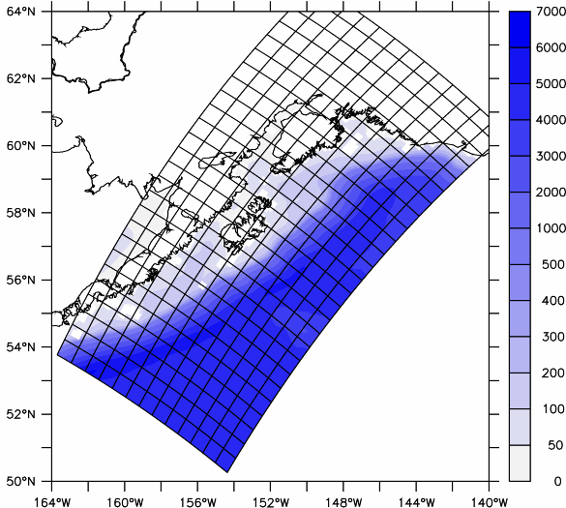
Strong Constraint Variational Data Assimilation
Surface Forcing
Model solution depends on:
Initial condition: x(0)
Surface forcing: f_{b}(t)
Boundary conditions: b_{b}(t)
Model parameters
ROMS
Open Boundaries
ROMS
x(t)
time
x_{b}(t)
x_{a}(t)
Obs (y)
(Background)
(Analysis)
Fiechter et al. (2011) Dyn. of Atmos. and Oceans 51 75-98. U.S. GLOBEC Contribution #101
Notes:
Extend the scenario where there are many observations, arranged in the vector y, with error covariance R.
The background now comes from a model with error covariance B.
Instead of obs at a single time, we consider obs from a finite time window.
And we seek an analysis that obeys the model equations to some degree; the model solution is controlled by initial and boundary conditions.

Slide 19
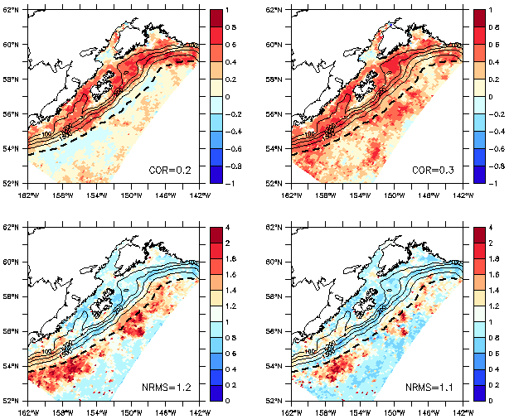
CGOA Surface Chlorophyll, 1998-2002
Model-Data correlations and RMS differences (NPZDFe-SeaWiFS)
(Assimilated datasets: AVISO ADT, Pathfinder SST, GLOBEC T/S)
Free-run
Data assimilative model
Correlation
“Eddy corridor”
Normalized RMSD
Notes:
Comparison of free run and data assimilative models with ocean color observations
N.B. Ocean color observations not assimilated, only physical variables
Question: does improved physics help the biological simulations?
Yes, in a very interesting way
Free run model has high correlation, low error on the shelf; low correlation and high error offshore where the eddy corridor is located.
Assimilating SLA and SST puts the eddies in the right place at the right time, improves fidelity of the biological simulation.

Slide 20
Linkage With Climate
U.S. GLOBEC report 0:
“There may be ways to mimic climatologists' use of atmospheric general circulation models in the coastal ocean for "long time scale" assessments…”

Slide 21
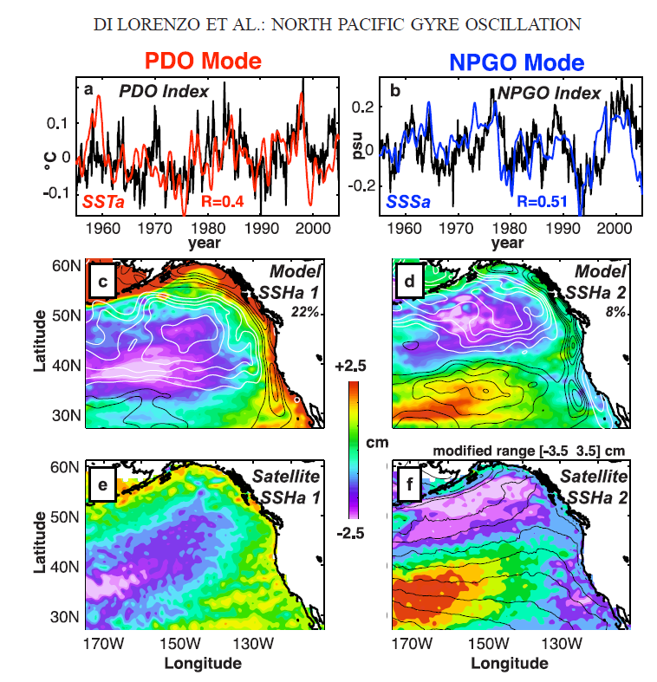
A basin-scale coupled physical-biological model reveals impacts of decadal variability on coastal ecosystems
See Enrique Curchitser’s talk tomorrow
Di Lorenzo et al. (2008) Geophys. Res. Lett. 35, L08607. U.S. GLOBEC Contribution #593
Notes:
Basin-scale modes of variability associated with the PDO and NPGO
Impacts on wind-driven upwelling and horizontal advection
Leads to variations in nutrient supply to plankton ecosystems in the coastal ocean

Slide 22
Applications to Resource Management

Slide 23
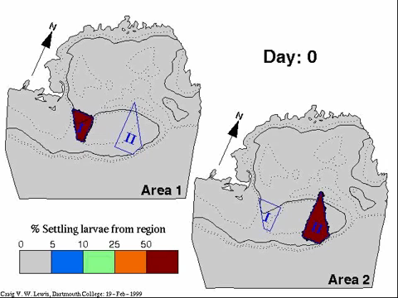
Use of particle tracking methods to inform management of scallops on Georges Bank
Adult Scallops – 1957-1980
Tremblay et al. (1994) Drift of sea scallop larvae Placopecten magellanicus on Georges Bank: A model study of the roles of mean advection, larval behaviour and larval origin. Deep-Sea Research II 41, 7-49. U.S. GLOBEC Contribution #1.
Notes:
These results were presented to the New England Fisheries Management Council in 1998, and to (then) Secretary of Commerce William M. Daley, to inform decisions on the reopening of closed areas of the bank to scalloping. Key locations within the existing closed areas were identified as important source areas for scallop larvae, including a designated Habitat Area of Particular Concern in Closed Area II (Figure 2). By demonstrating the importance of the closed area through model visualization, US GLOBEC was able to support maintaining the closure in this region.
Now one of the most lucrative fisheries in the US, generating in excess of $250M in ex-vessel value.

Slide 24
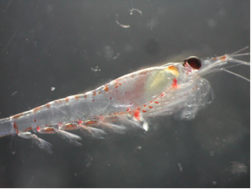

The PDO and marine food chains in the northern California Current: source waters, copepods and salmon
Bill Peterson
Senior Scientist
NOAA Fisheries
Hatfield Marine Science Center
Newport Oregon
        See www.nwfsc.noaa.gov, “Ocean Conditions and Salmon Forecasting”

Slide 25
We are contributing to salmon management by studying the ocean phase of their life history and by developing management advice based on a suite of physical, biological and ecological indicators of ocean conditions
Large scale forces acting at the local scale can influence biological process important for salmon
PDO
Local Conditions
Upwelling & SST
Spring Transition
Coastal currents
ENSO
Local Biological Conditions

Slide 26
A chain of events (in a perfect year)
Changes in basin-scale winds lead to sign changes in PDO
SST changes as do water types off Oregon
Spring transition
Upwelling season
Zooplankton species
Food Chain
Forage Fish
Juvenile salmonids
Negative Positive
Cold/salty Warm/fresh
Early Late
Long Short
Cold species Warm species
Lipid-rich Lipid-deplete
Many Few
Many Few
But time lags can complicate interpretations!
as do pesky El Niño events

Slide 27
1998, 2003-2005 = warm & unproductive; poor salmon returns
1999-2002 and 2008 = cold & productive; record returns
2010 = a mixed bag—poor early, great late!

Slide 28
Statistical Robustness of the salmon forecasts
Spring Chinook
p=0.007
Fall Chinook
p=0.009
Coho
p=0.02
Salmon counts
(Bonneville Dam)
Mean rank of environmental variables
Notes:
An example of ecosystem-based management

Slide 29
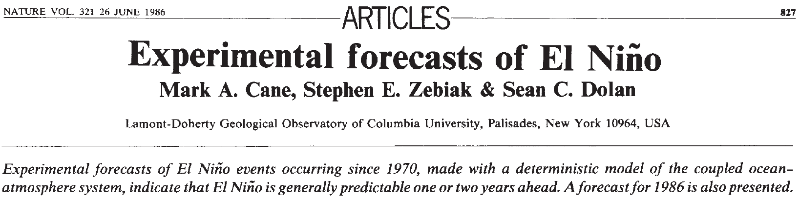
A cautionary tale from the physical climate system
Notes:
Lessons learned here are in some ways reminiscent of the development of El Niño – Southern Oscillation (ENSO) phenomena. The introduction of dynamical forecast models in the 1980s (Cane et al. 1986) led to several years of remarkably skillful predictions (Latif et al. 1998). In the 1990s, there was a significant drop in forecast skill when ENSO entered a distinctly different mode of variability (Ji et al. 1996)—which ushered in a new wave of model improvement (Chen et al. 1995). Indeed, long-term hindcasting studies suggest interdecadal variations in ENSO predictability that reflect temporal changes the underlying dynamics of the system (Chen et al. 2004). It can be argued that ecological forecasting will be even more prone to fluctuations in predictability than the physical climate system, owing to even stronger nonlinearities in biological dynamics (Frank et al. 1994). As such, assimilation of data will be essential to keep predictive ecological models on track. Although data assimilation into coupled physical-biological models is still in its infancy (Hofmann and Friedrichs 2002), there are some promising inroads being made (Gregg et al. 2009). In any case, the 2010 A. fundyense bloom in the Gulf of Maine highlights the need for intimate connection between observational networks and forecast systems, and how these aspects must evolve together to meet the grand challenge of ecological forecasting in the ocean.

Slide 30
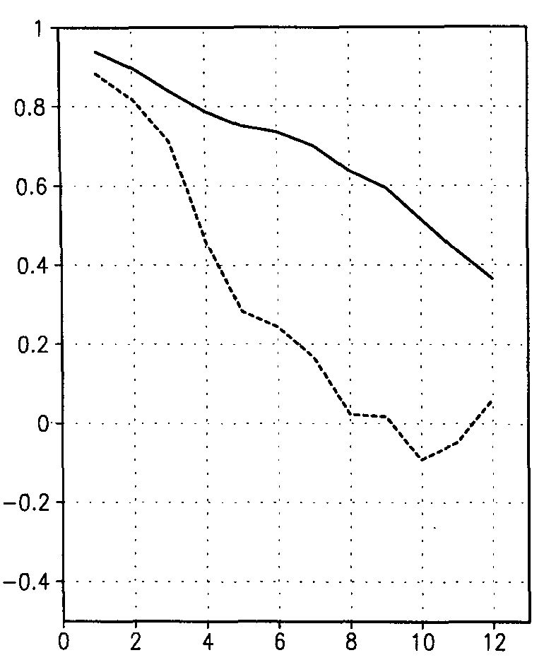
Regime shifts can change the underlying dynamics
Ji et al. (1996) Journal of Climate 9, 3105-3120.
1982-1992
W
Correlation
(forecast, obs)
1992-1995
C
W
Lag (months)
C
Chen et al. (1995) Science 269, 1699-1702. An improved procedure for El Nino forecasting: implications for predictability.
W

Slide 31
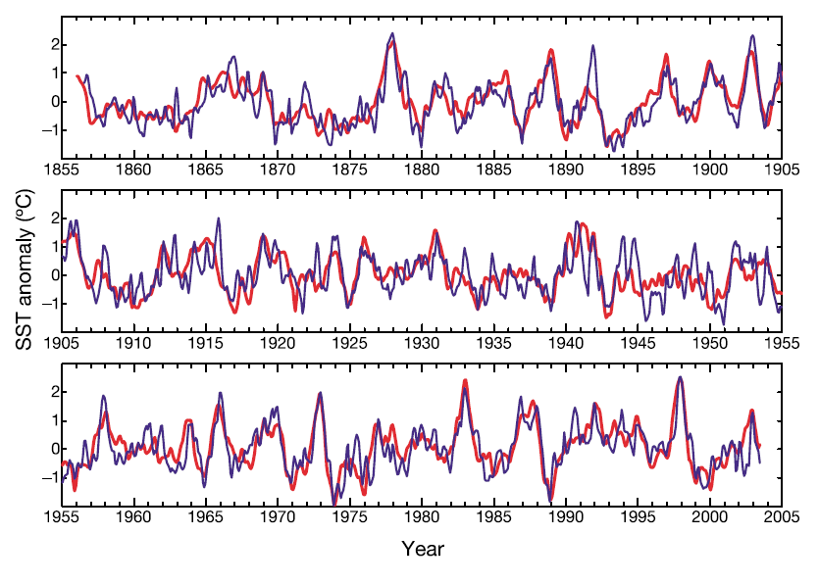
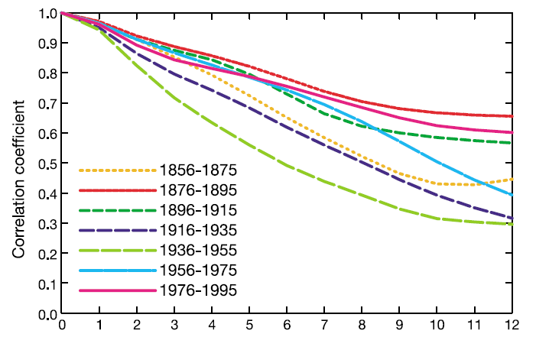
Changing dynamics can lead to variations in predictability
Correlation
(forecast, obs)
Chen et al. (2004) Nature 428, 733-736. Predictability of El Nino over the last 148 years.

Slide 32
Looking forward
Long-term observational networks are essential
Data assimilation to keep models on track
Process studies to understand changing dynamics
Coordinated interdisciplinary process studies of the scale of GLOBEC are needed to understand ecosystem dynamics on local, regional, and global scales.

Slide 33
Thank you
Hal Batchelder
Nick Bond
Cabell Davis
Mike Dinniman
Jerome Fiechter
Bob Groman
Dale Haidvogel
Al Hermann
Eileen Hofmann
Rubao Ji
Dan Lynch
David Mountain
Bill Peterson
Jeff Runge
Beth Turner
Cisco Werner

